Slide 1



Archi Modeling in ArchiSurance

Slide 2
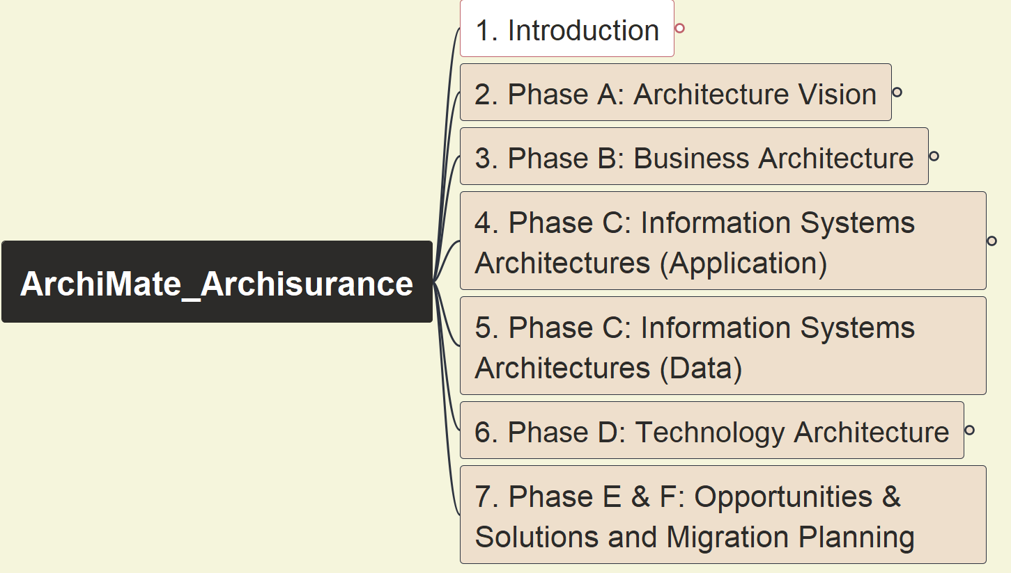
Opening and Course Introduction
ArchiSurance 2025
001

Slide 3

About Me – Xiaoqi Zhao (and archi. Related)
25+ years in IT field, 10+ years as Enterprise Architect
ITIL Manager in 2002, PMP in 2003
OpenGroup TOGAF 9 Certified in 2013
ArchiMate 3 Certified in 2021
Gain OpenGroup Level 2 Architect in 2021 as well
Skillful on Architecture Abstracting and Modeling
Actively using EA tools, diagramming tools
Learn by doing, share by practicing… also for FUN!

Slide 4
Why This Course – ArchiSurance 2025
I had packaged and shared ArchiSurance Practice in 2023, gained interests by variable architect roles
46 Videos, Viewed 20K+ times, 730 hours
The course was selected into Udemy Business in Q4 2024, and as the only one relating to “ArchiSurance” topic there, ~ 400 students
Since that series of demo were based on mixed version 3.1 and 3.2, and have collected numerous feedbacks from students, I’d like to develop one new version of this course fully basing on version 3.2, also, take chance to improve the course recording technic
Archi tool has been upgraded to v5.5.0 with fully complying with ArchiMate 3.2, which will be used in the new course

Slide 5
Key Learning Information for your Aware
Course structure will be managed in Mindmap via FreePlane tool
Every lecture aims to finish one view
Gradually build up Enterprise Architecture Repository for ArchiSurance
Generate and archive one snapshot model right after every view modeling
Models and information is tracked in new GitHub repository: https://github.com/yasenstar/ArchiMate_ArchiSurance
Do not watch only! Open Archi and do modeling yourself!

Slide 6
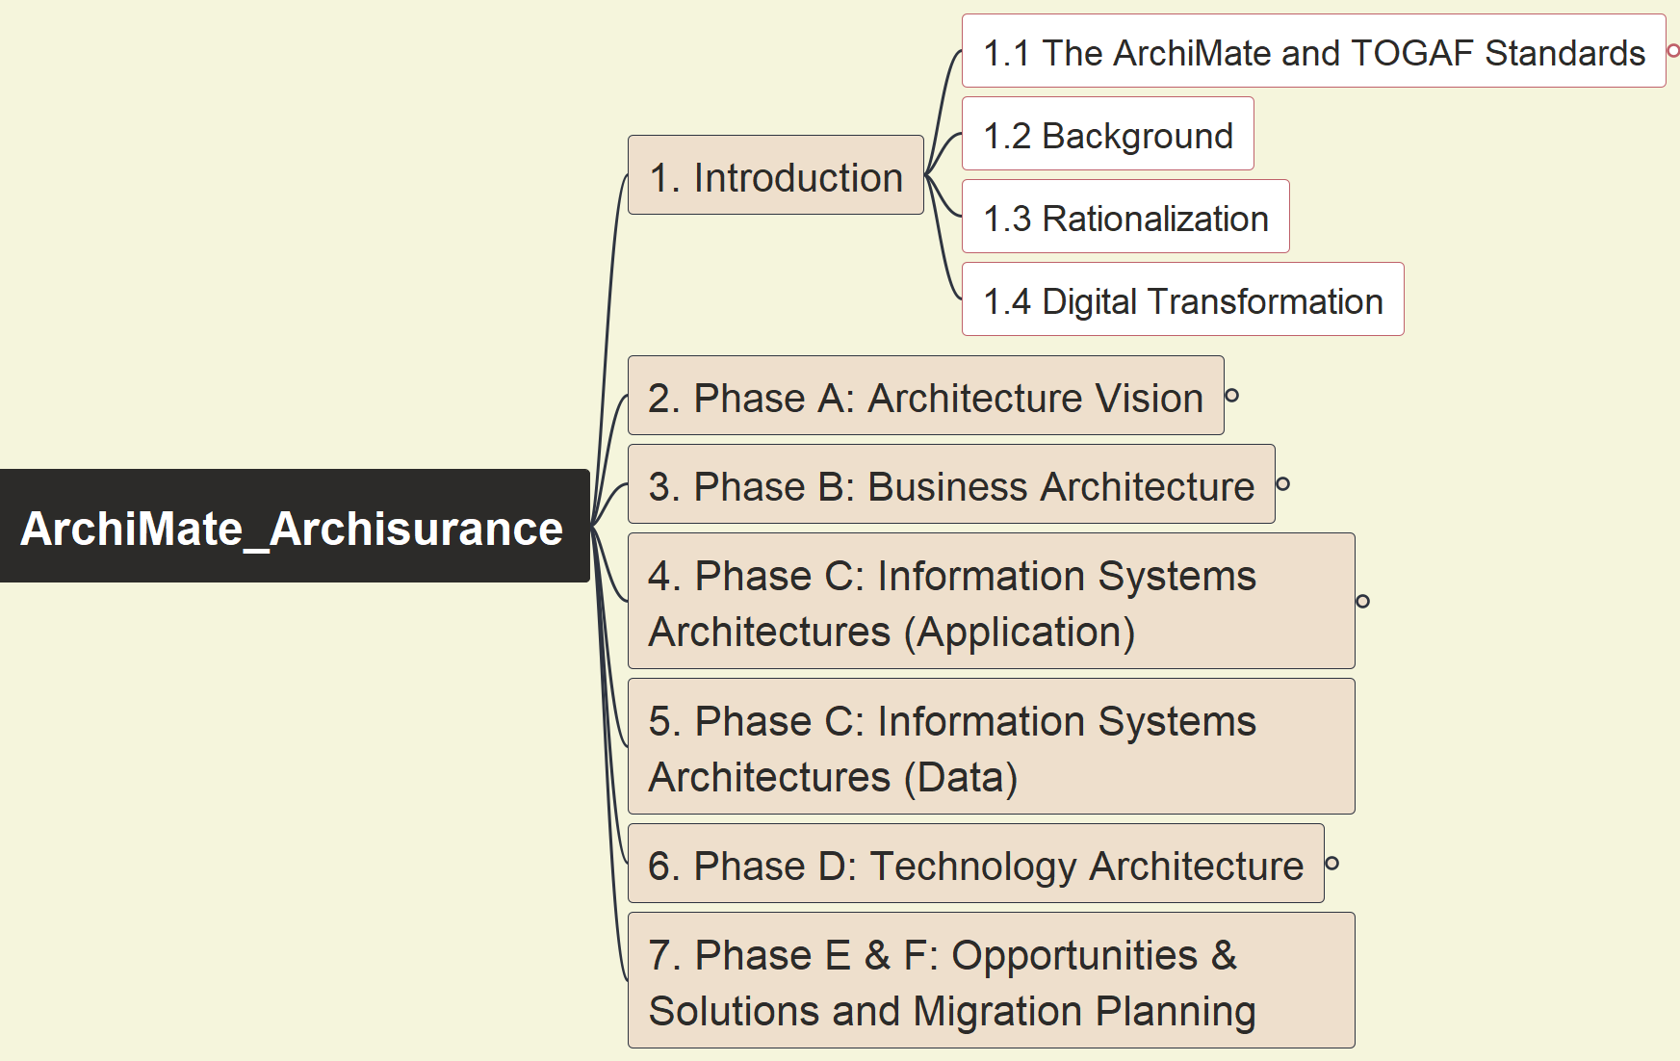
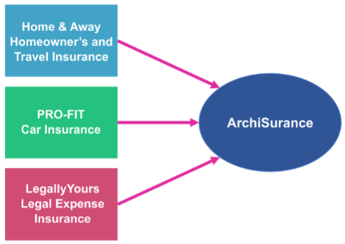
ArchiSurance Case Study Overview & Intro
ArchiSurance 2025
002

Slide 7
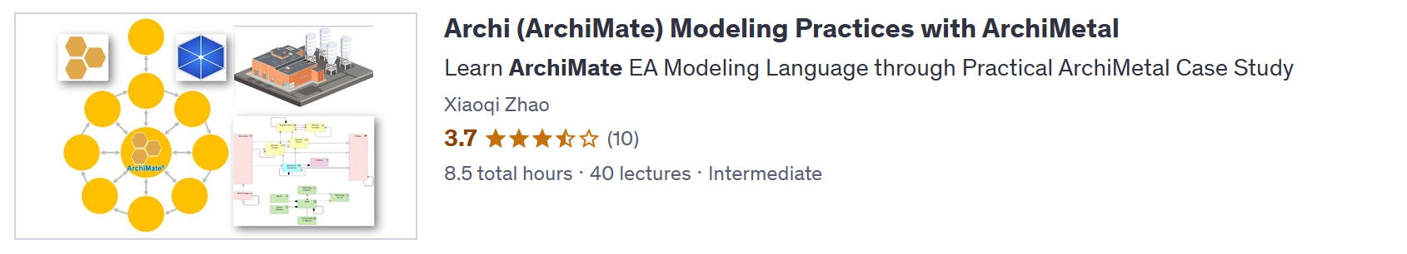
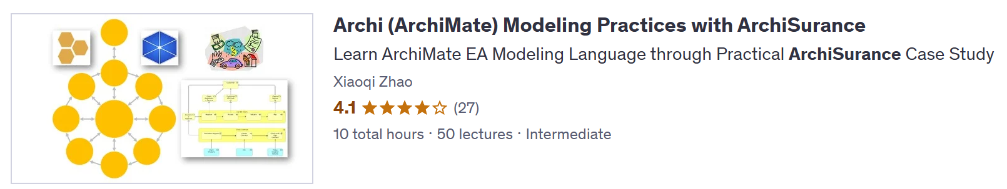
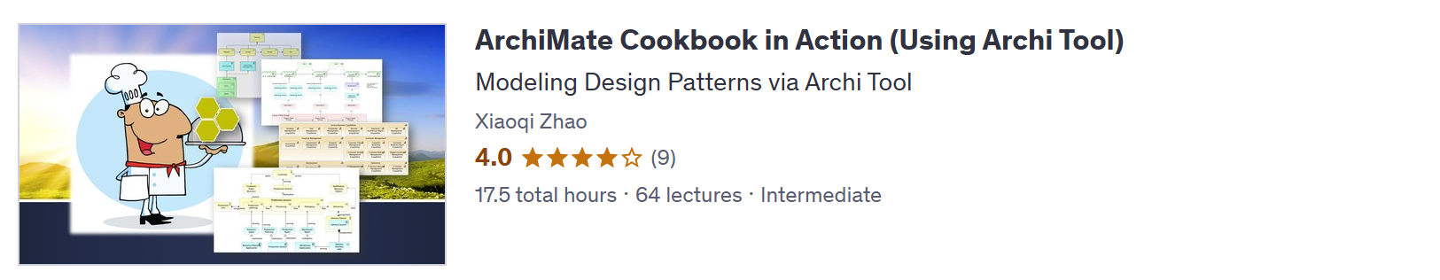
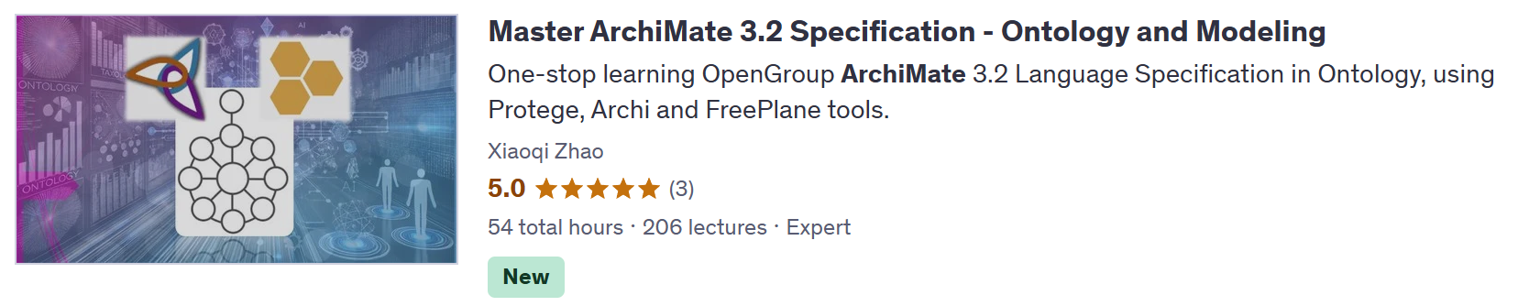
Check Other Related Course

Slide 8
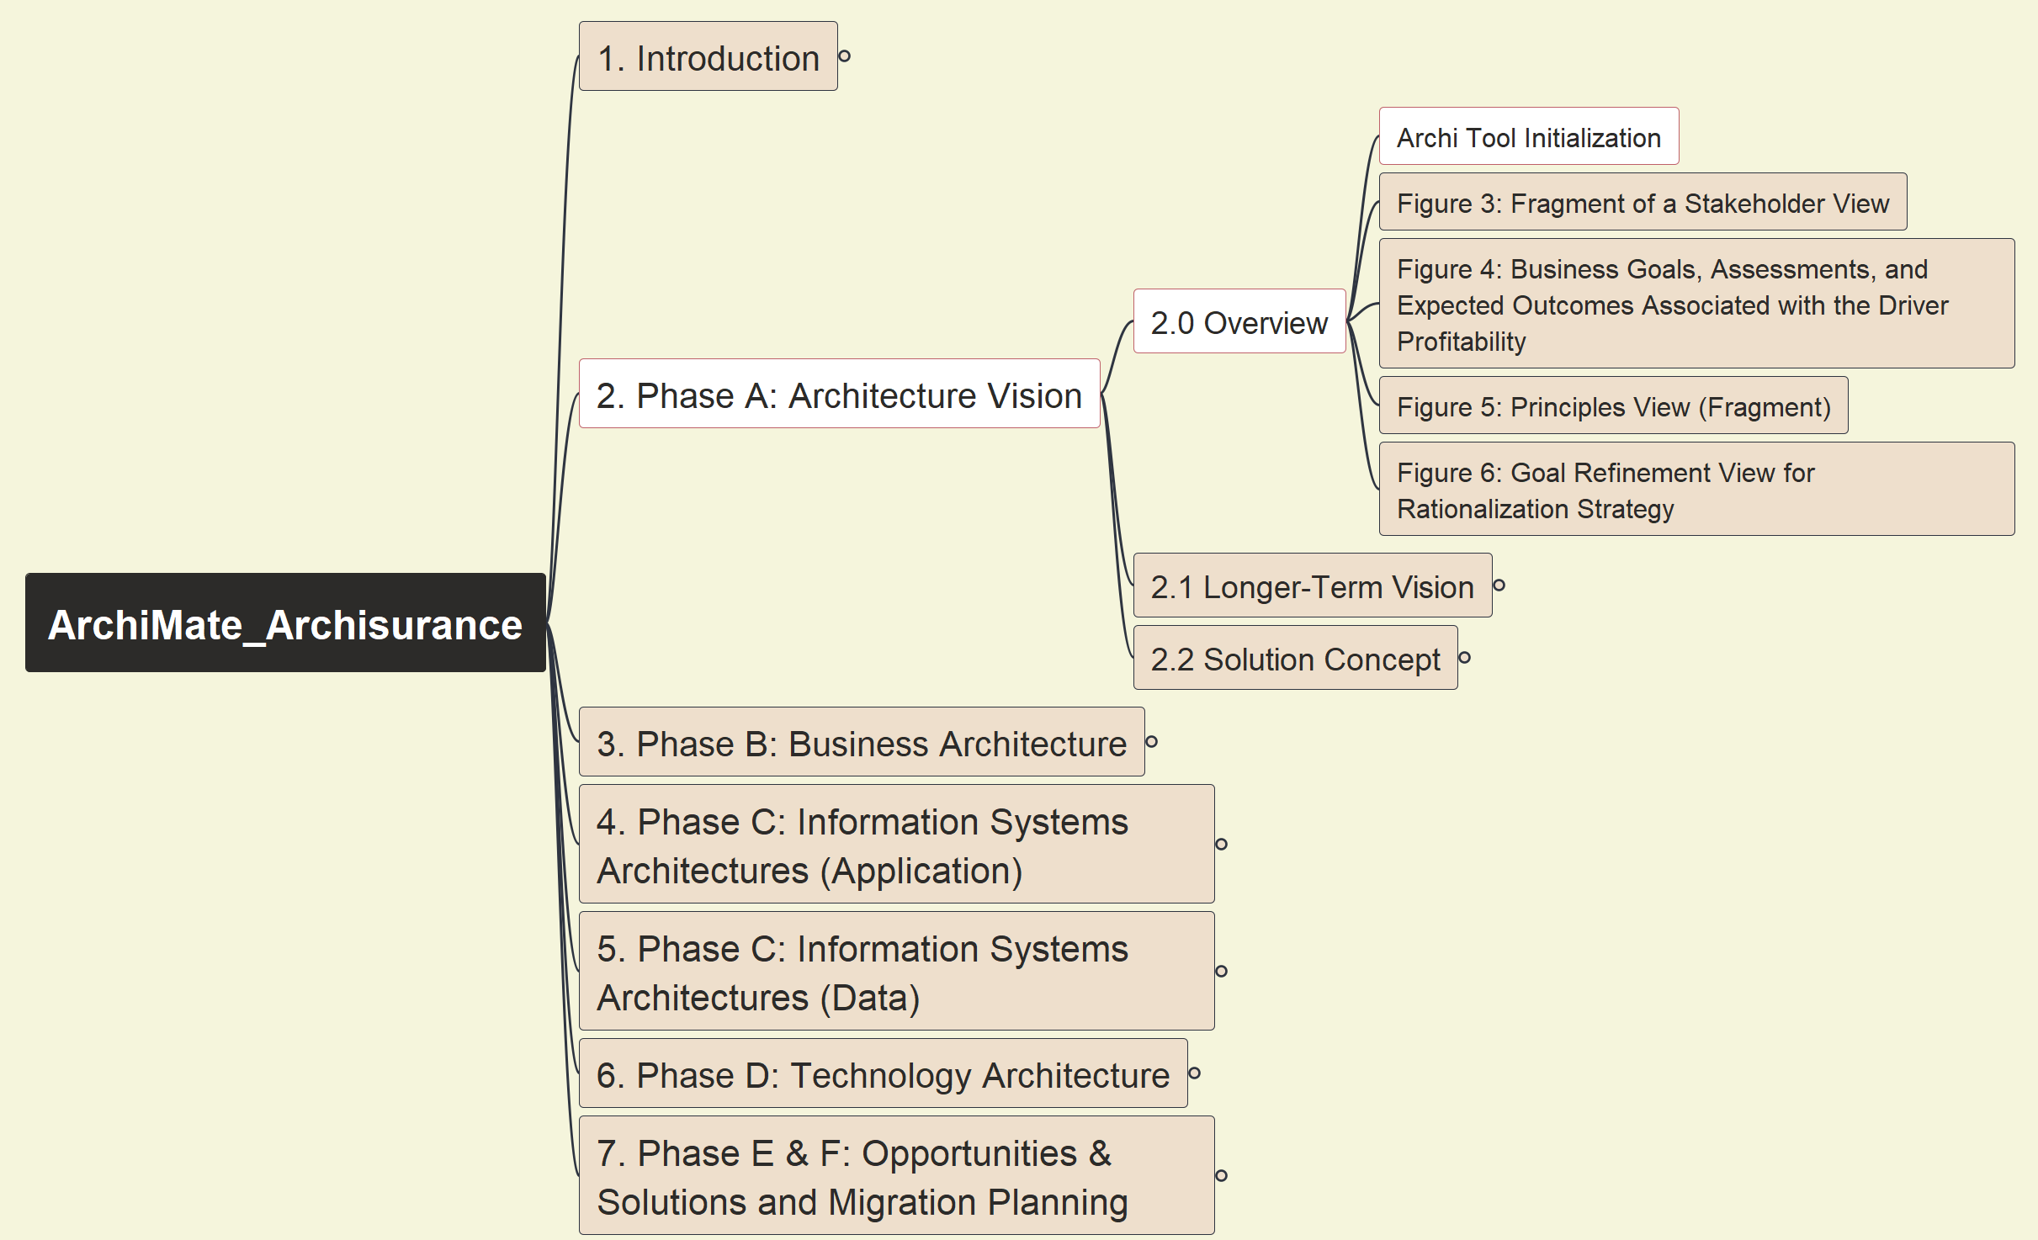
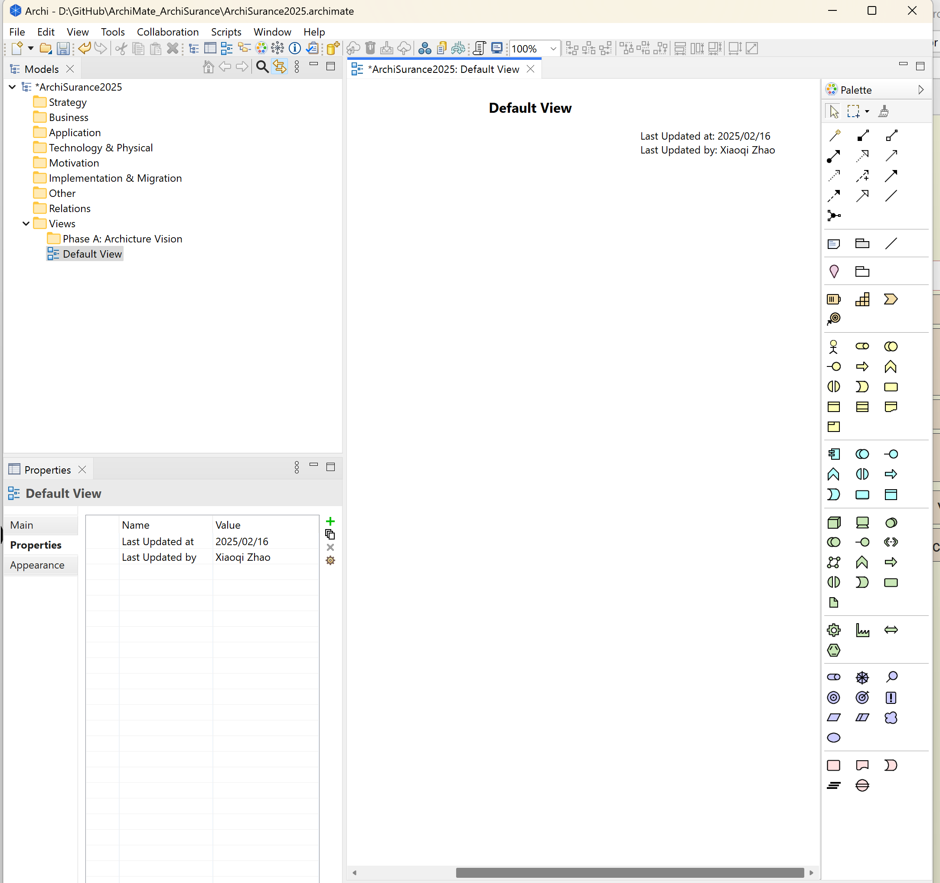
Archi Tool Initialization
ArchiSurance 2025
003

Slide 9
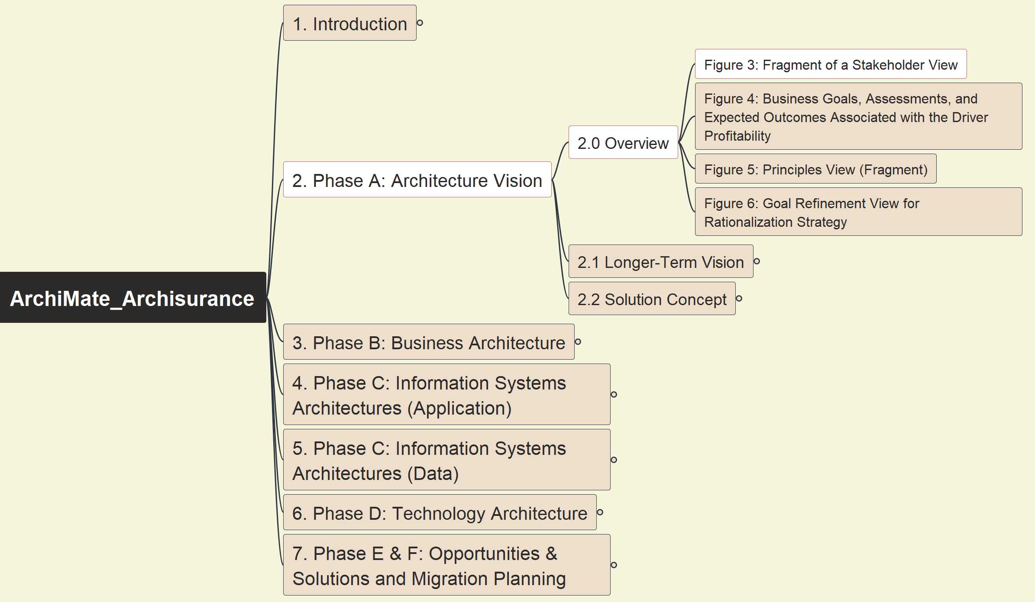
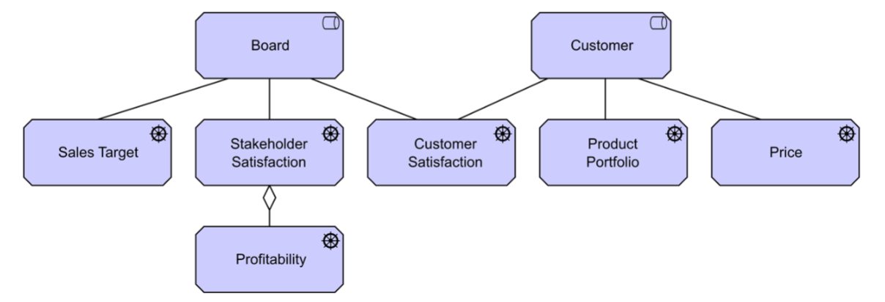
Phase A: Architecture Vision - Stakeholder View
ArchiSurance 2025
004

Slide 10
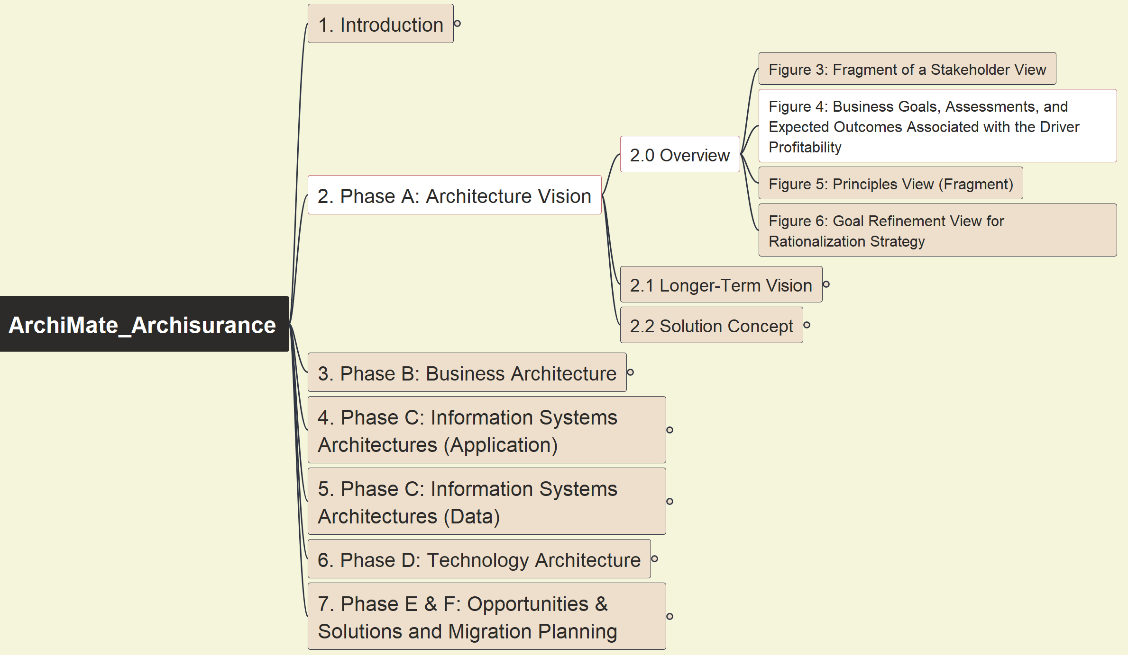
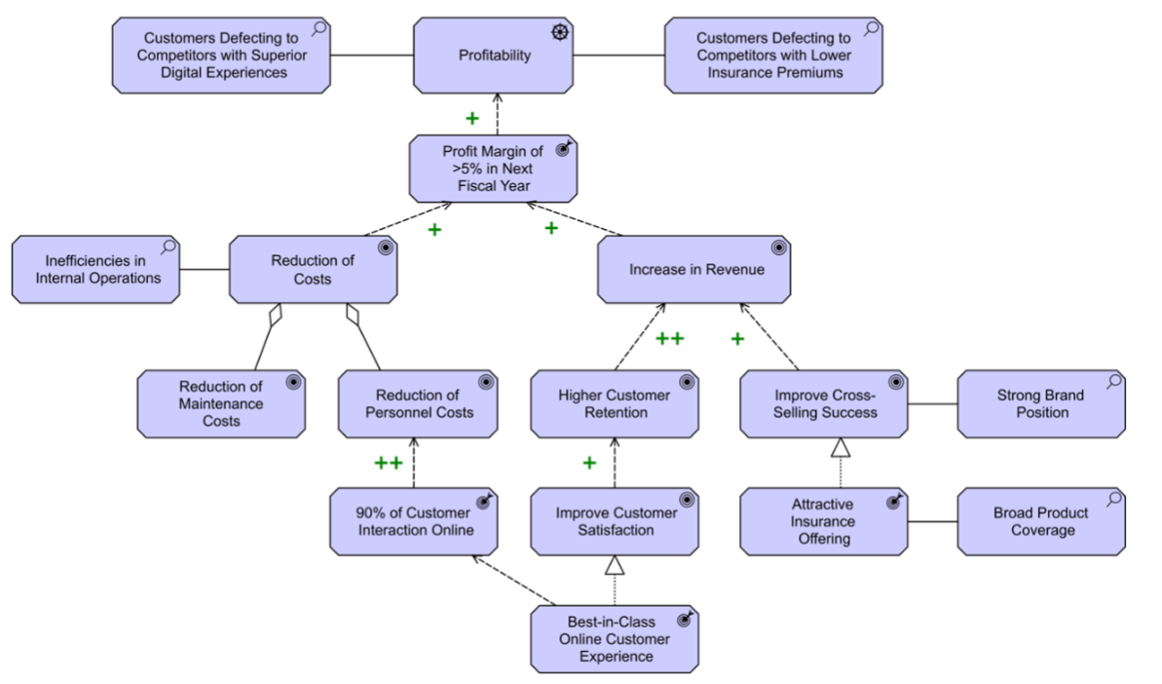
Phase A: Architecture Vision - Business Goals, Assessments, Outcomes
ArchiSurance 2025
005

Slide 11
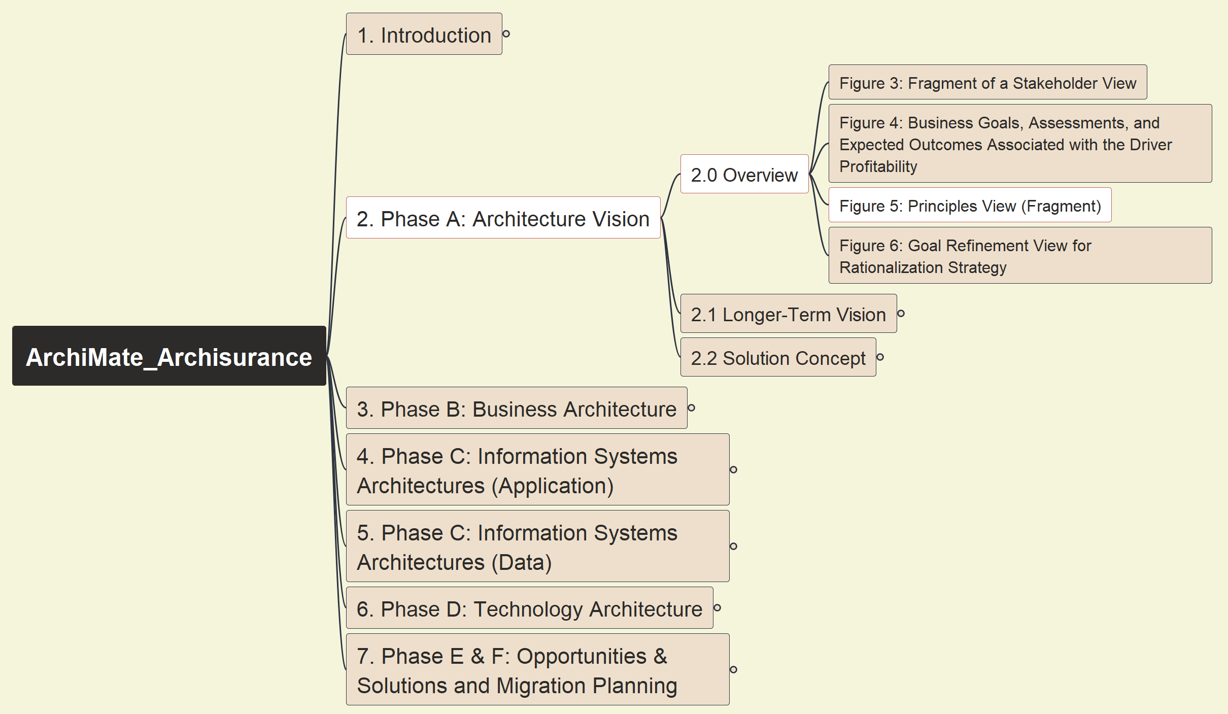
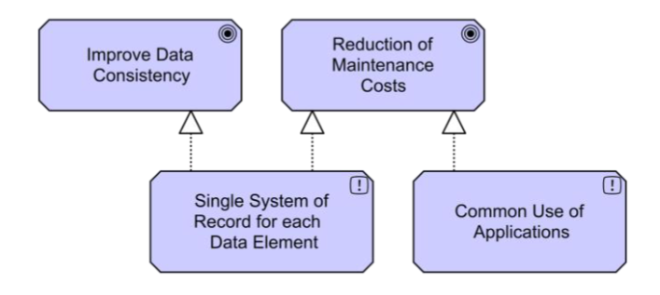
Phase A: Architecture Vision - Principles View
ArchiSurance 2025
006

Slide 12
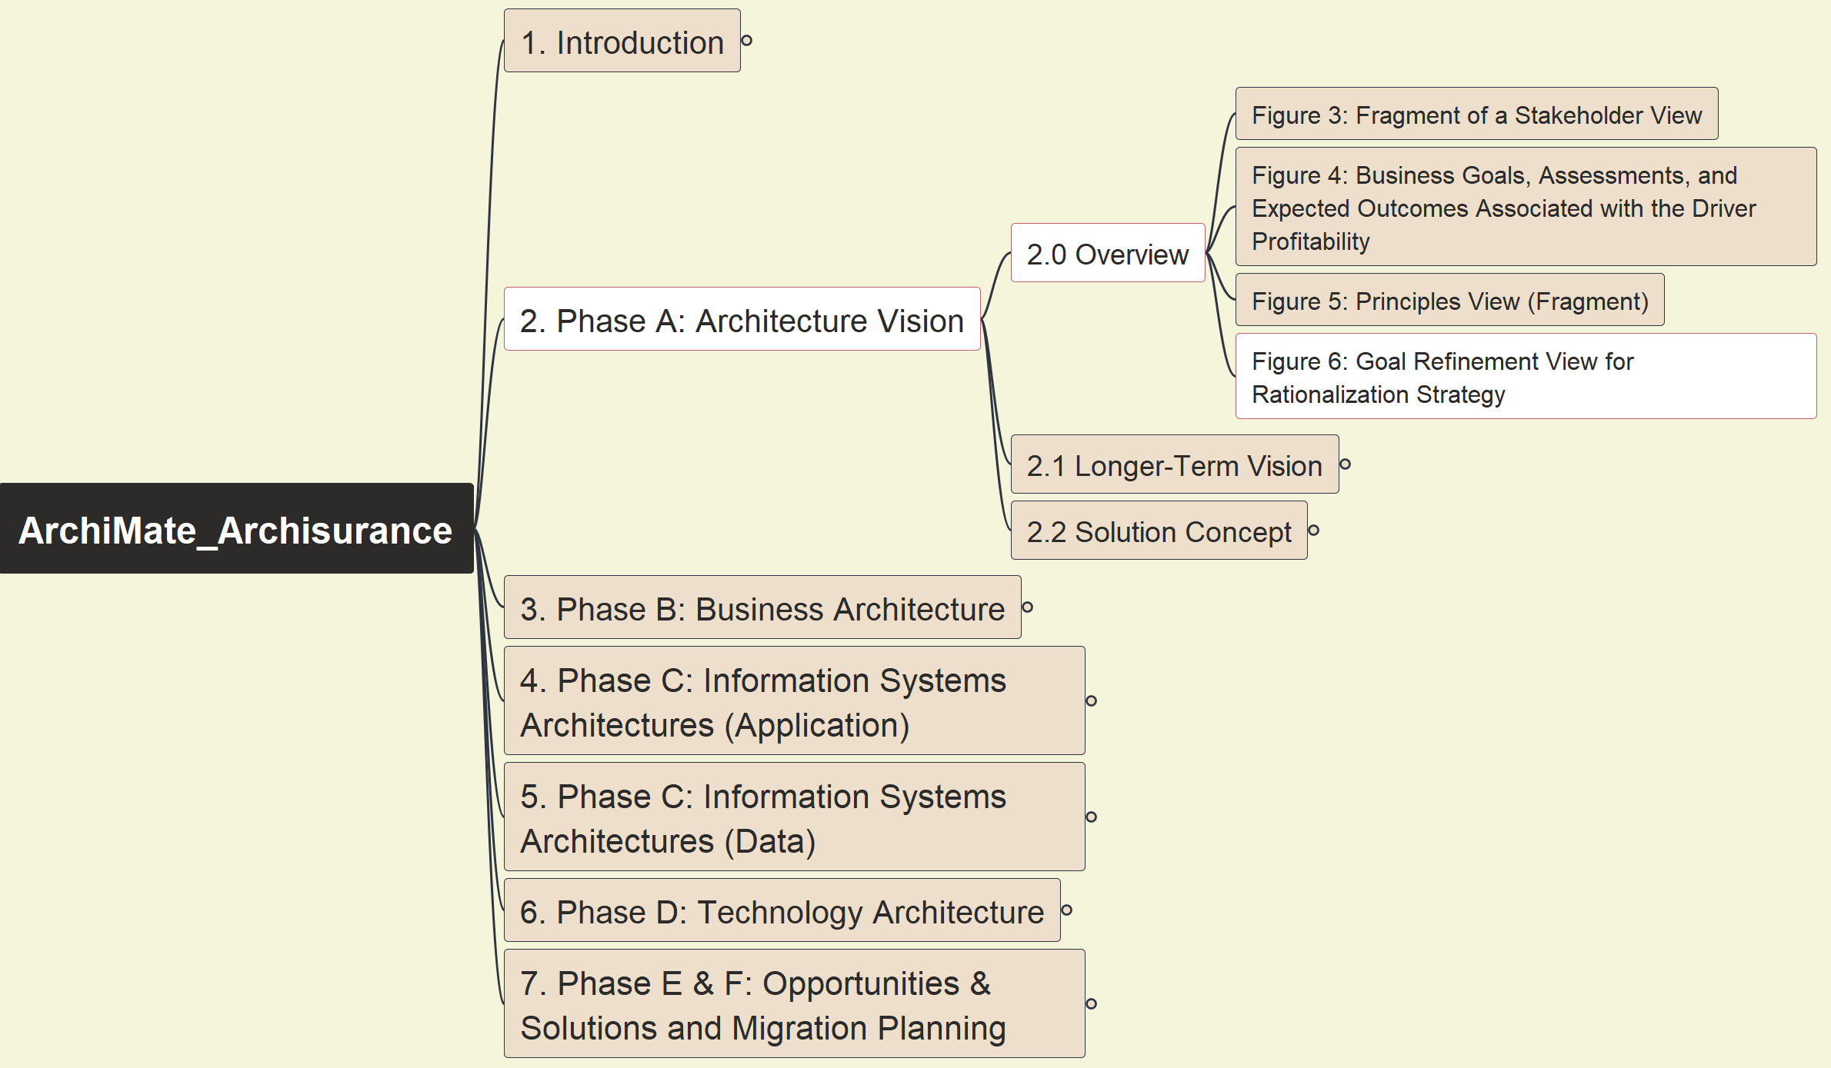
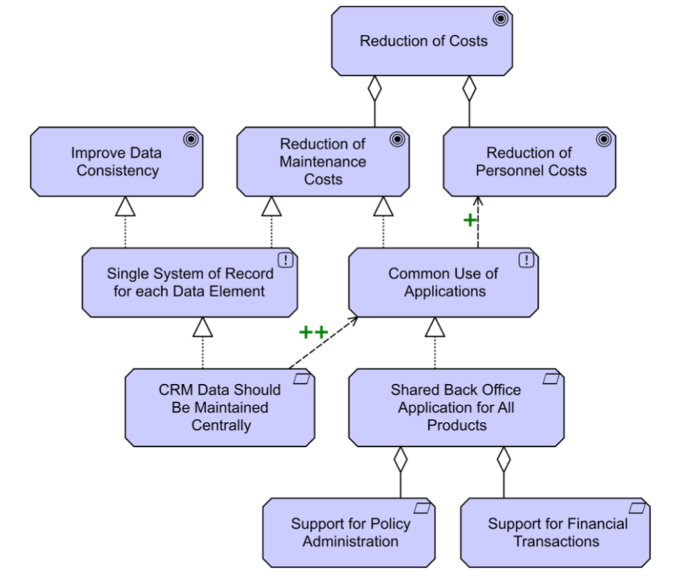
Phase A: Architecture Vision - Goal Refinement View for Rationalization Strategy
ArchiSurance 2025
007

Slide 13
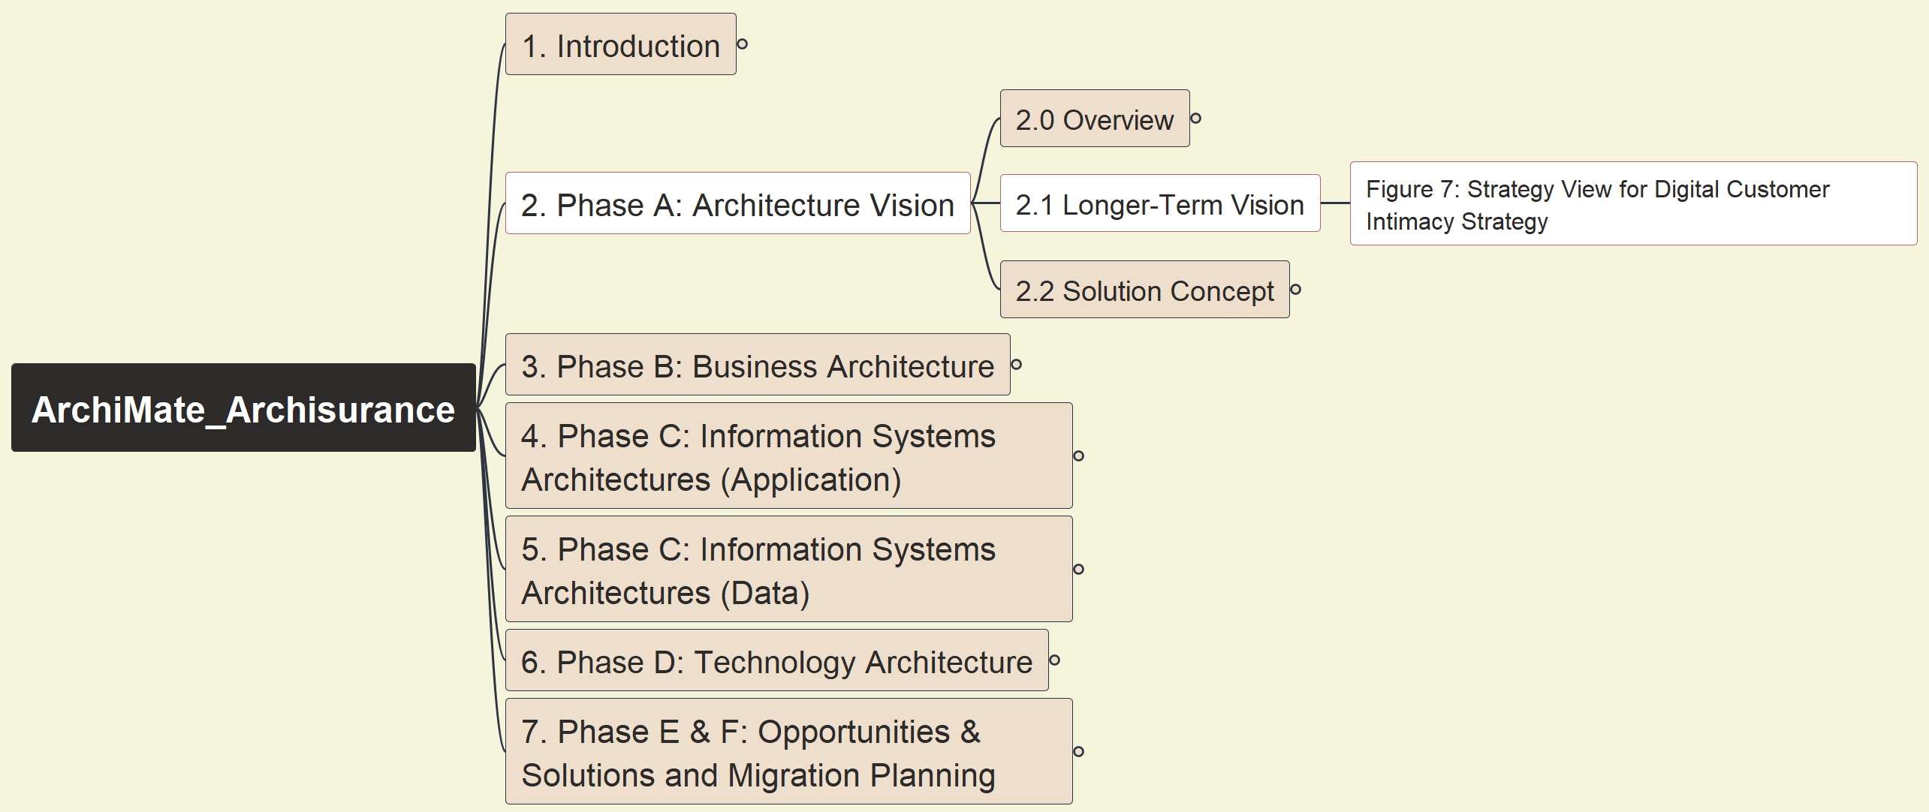
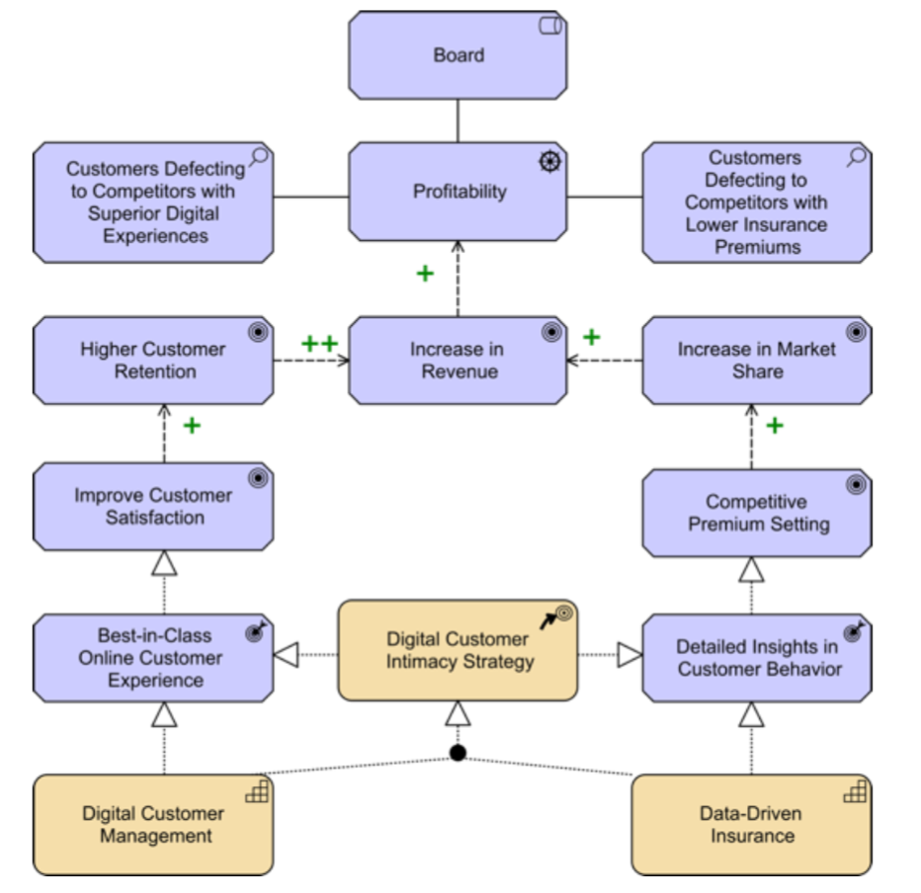
Phase A: Architecture Vision - Strategy View for Digital Customer Intimacy Strategy
ArchiSurance 2025
008

Slide 14
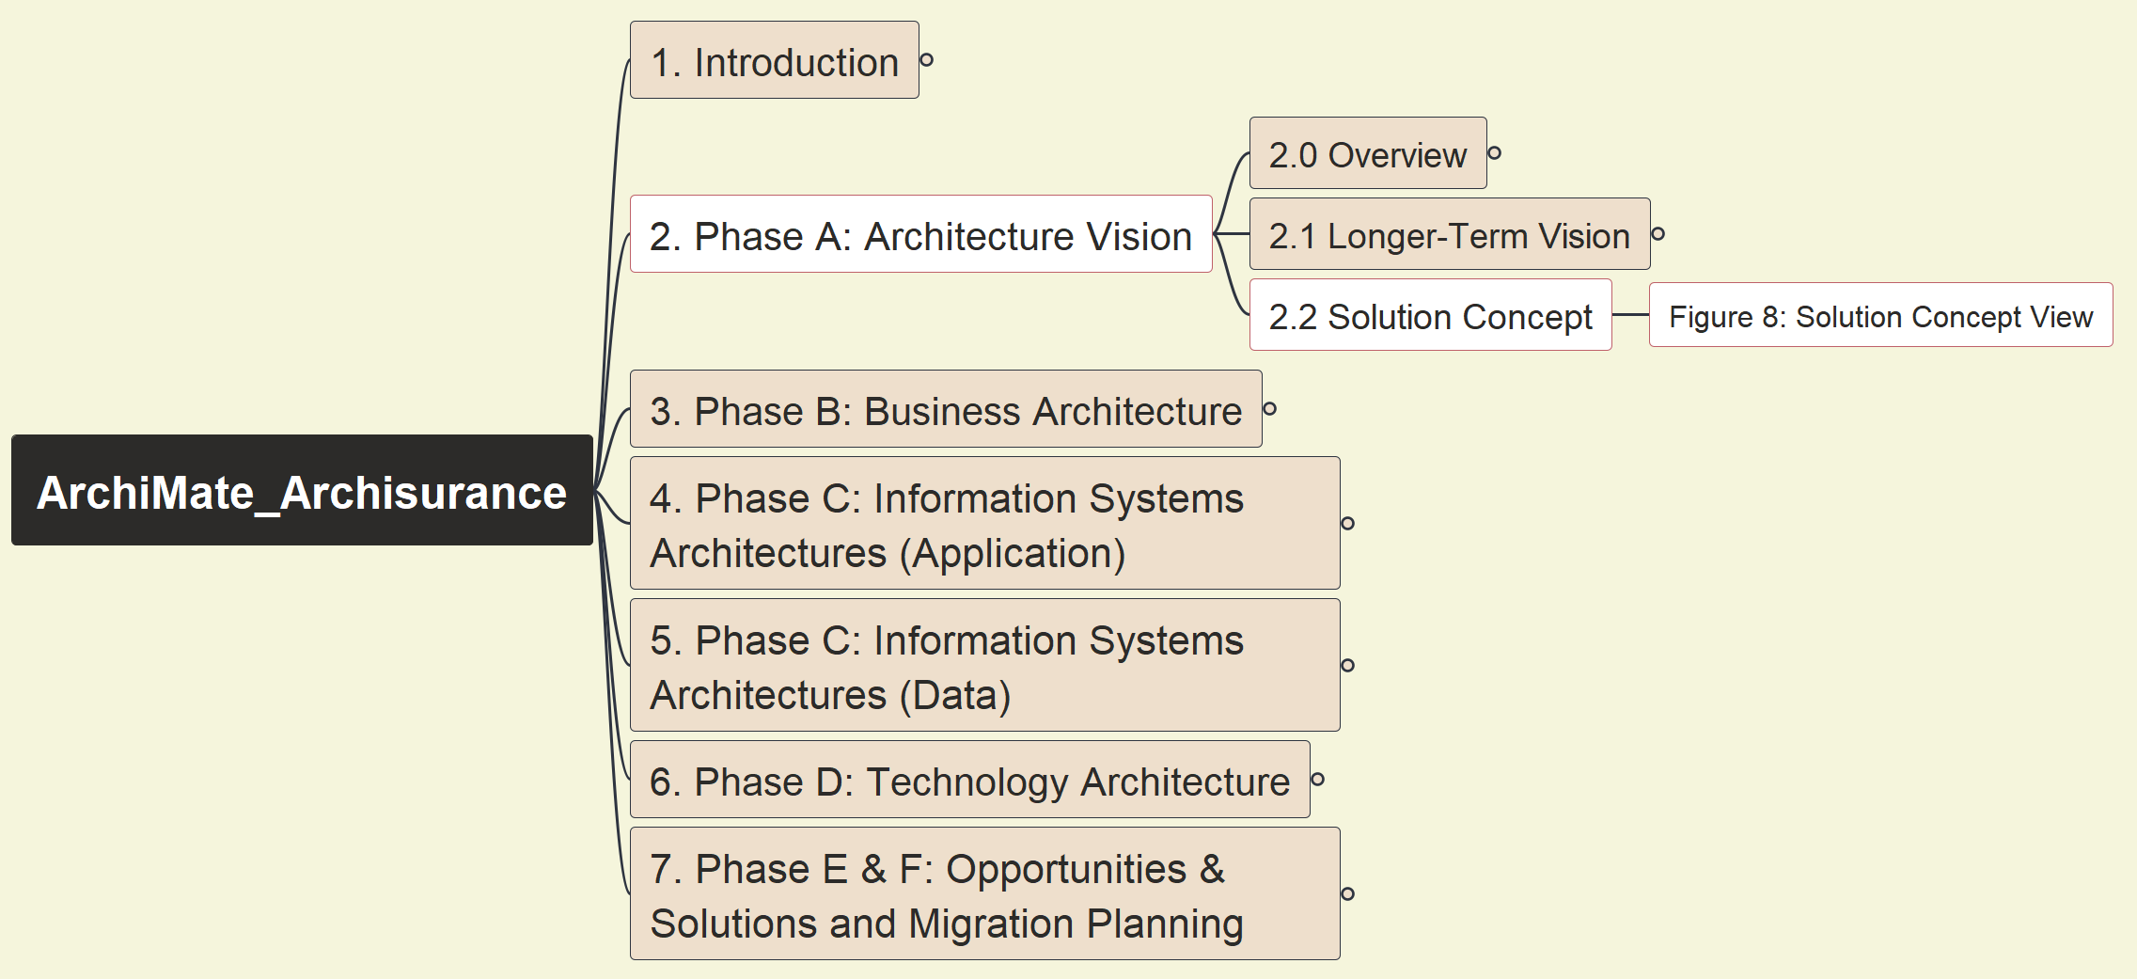
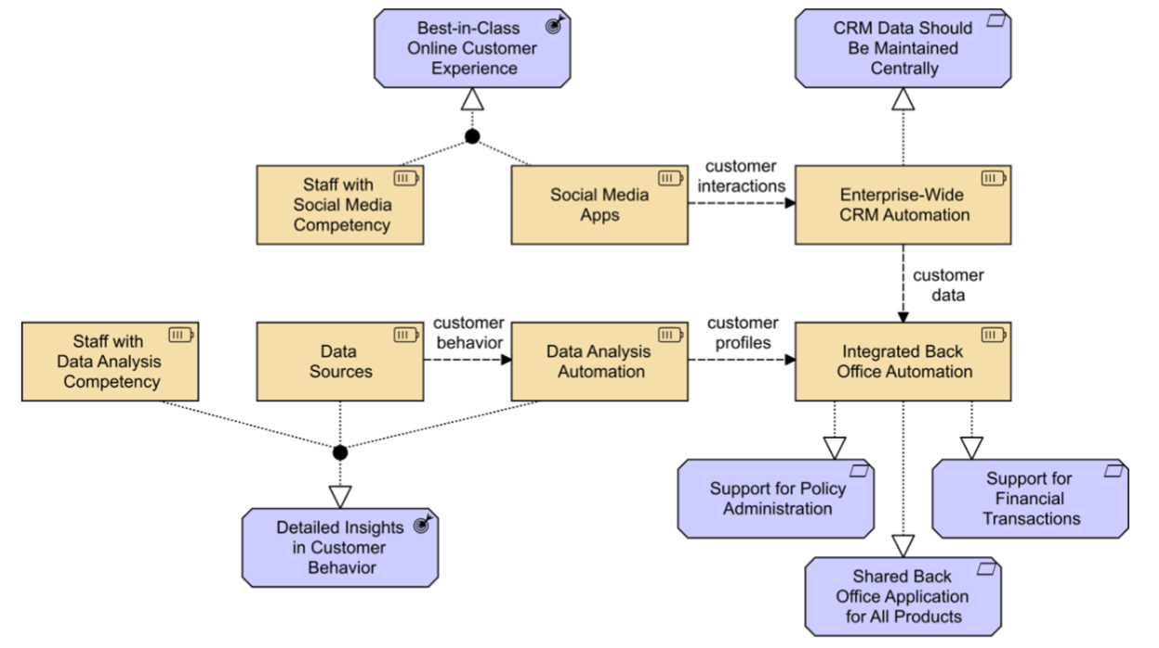
Phase A: Architecture Vision - Figure 08: Solution Concept View
ArchiSurance 2025
009

Slide 15
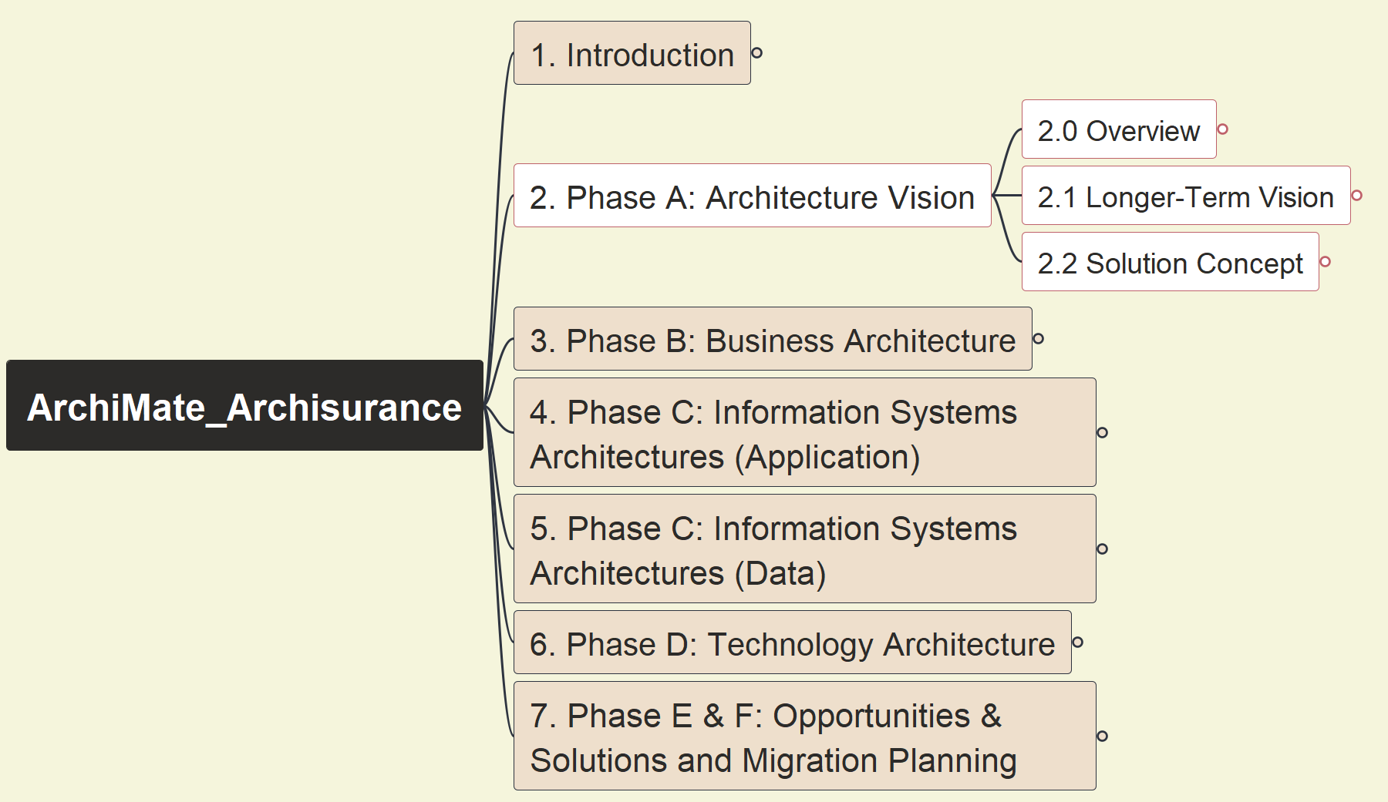
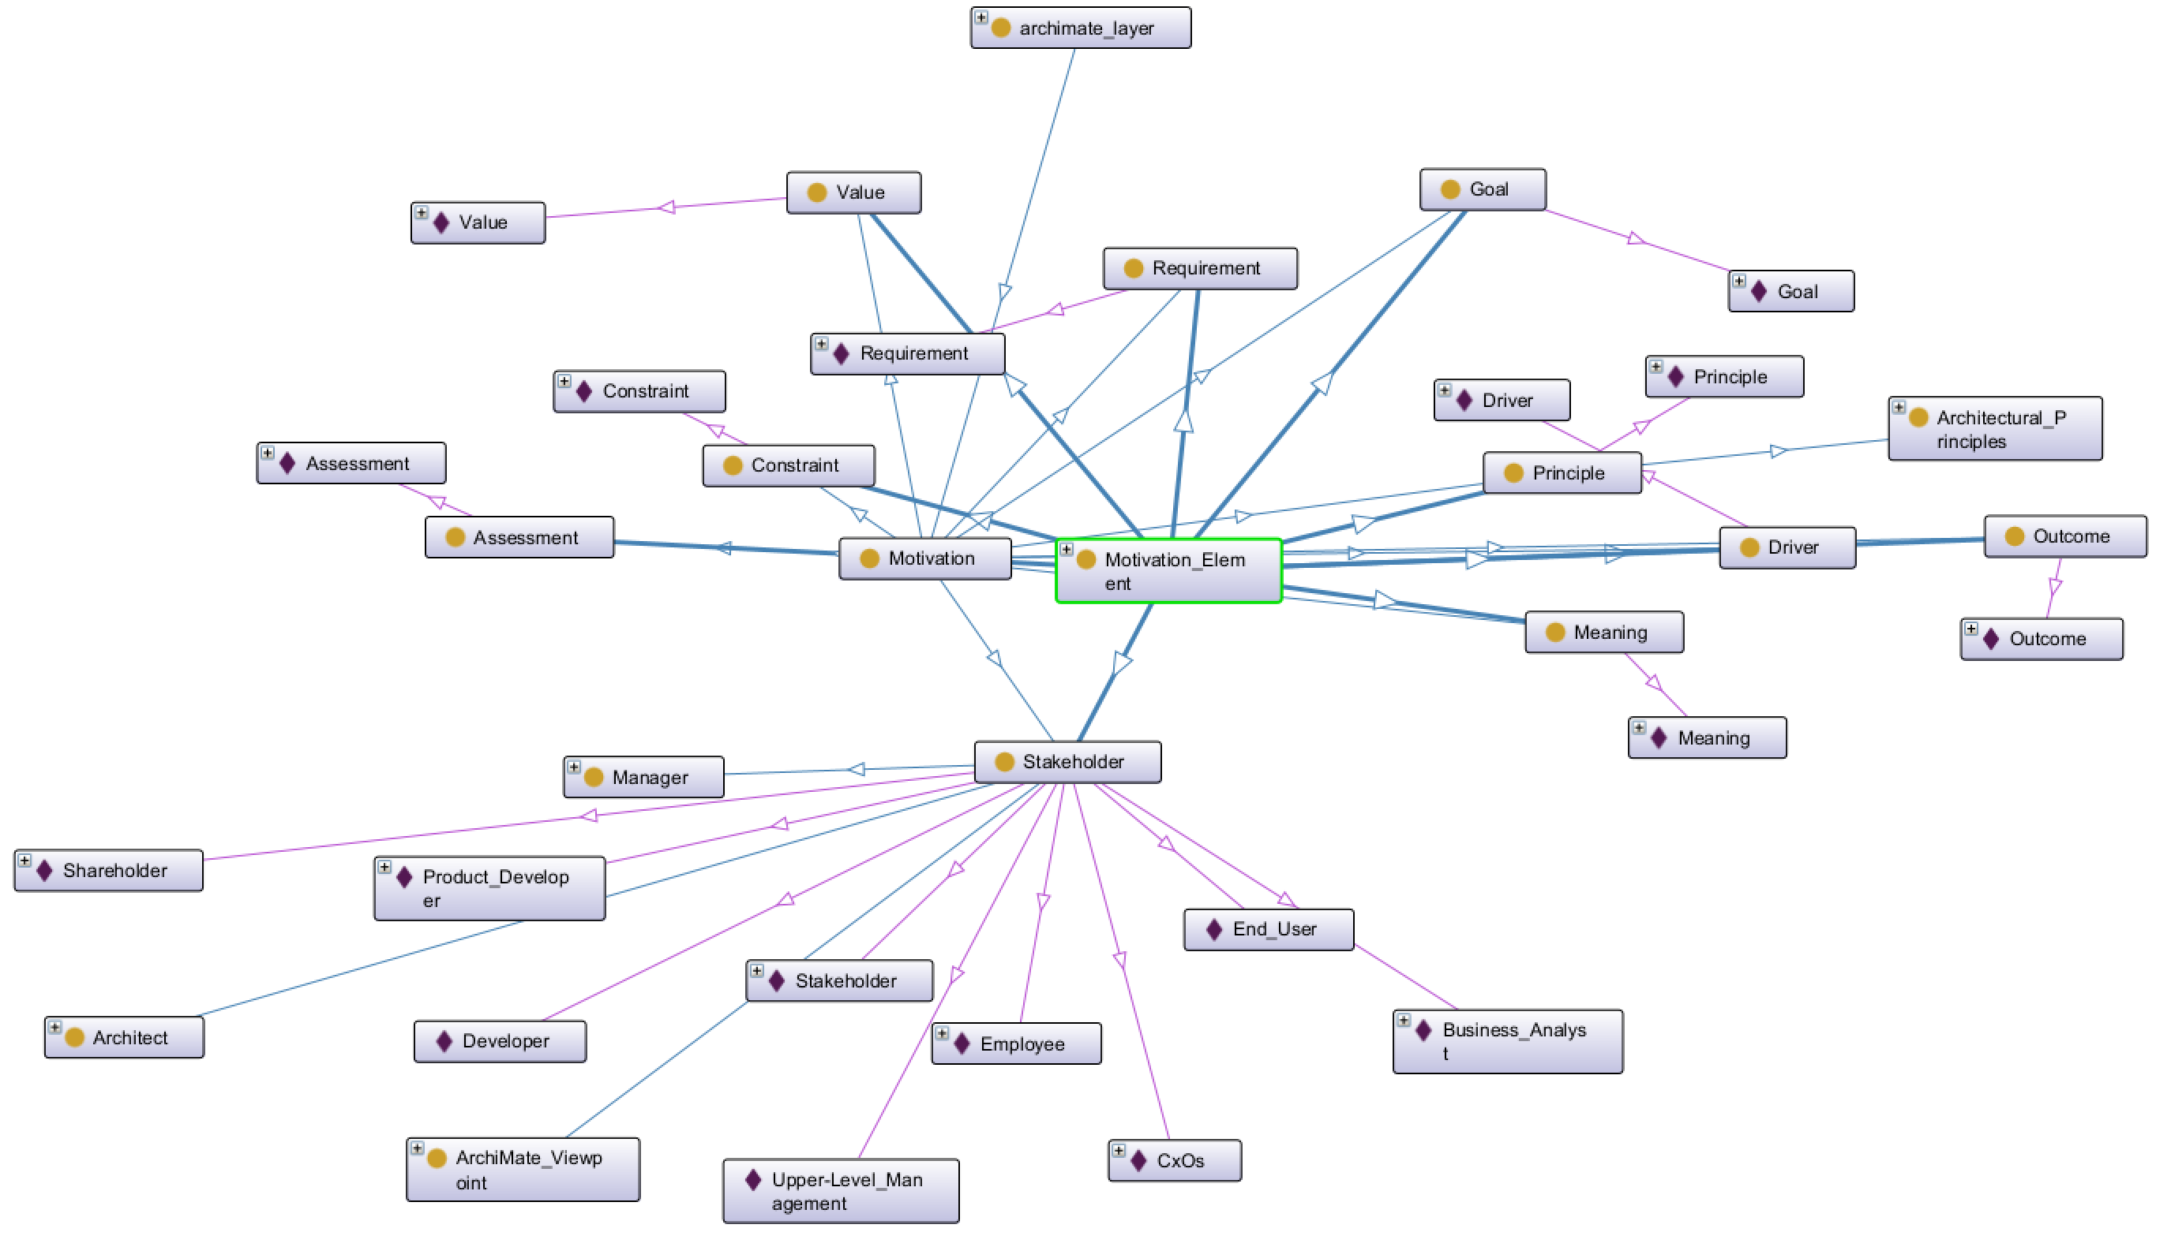

Phase A: Architecture Vision - Ontology View on Motivation Layer
ArchiSurance 2025
010

Slide 16
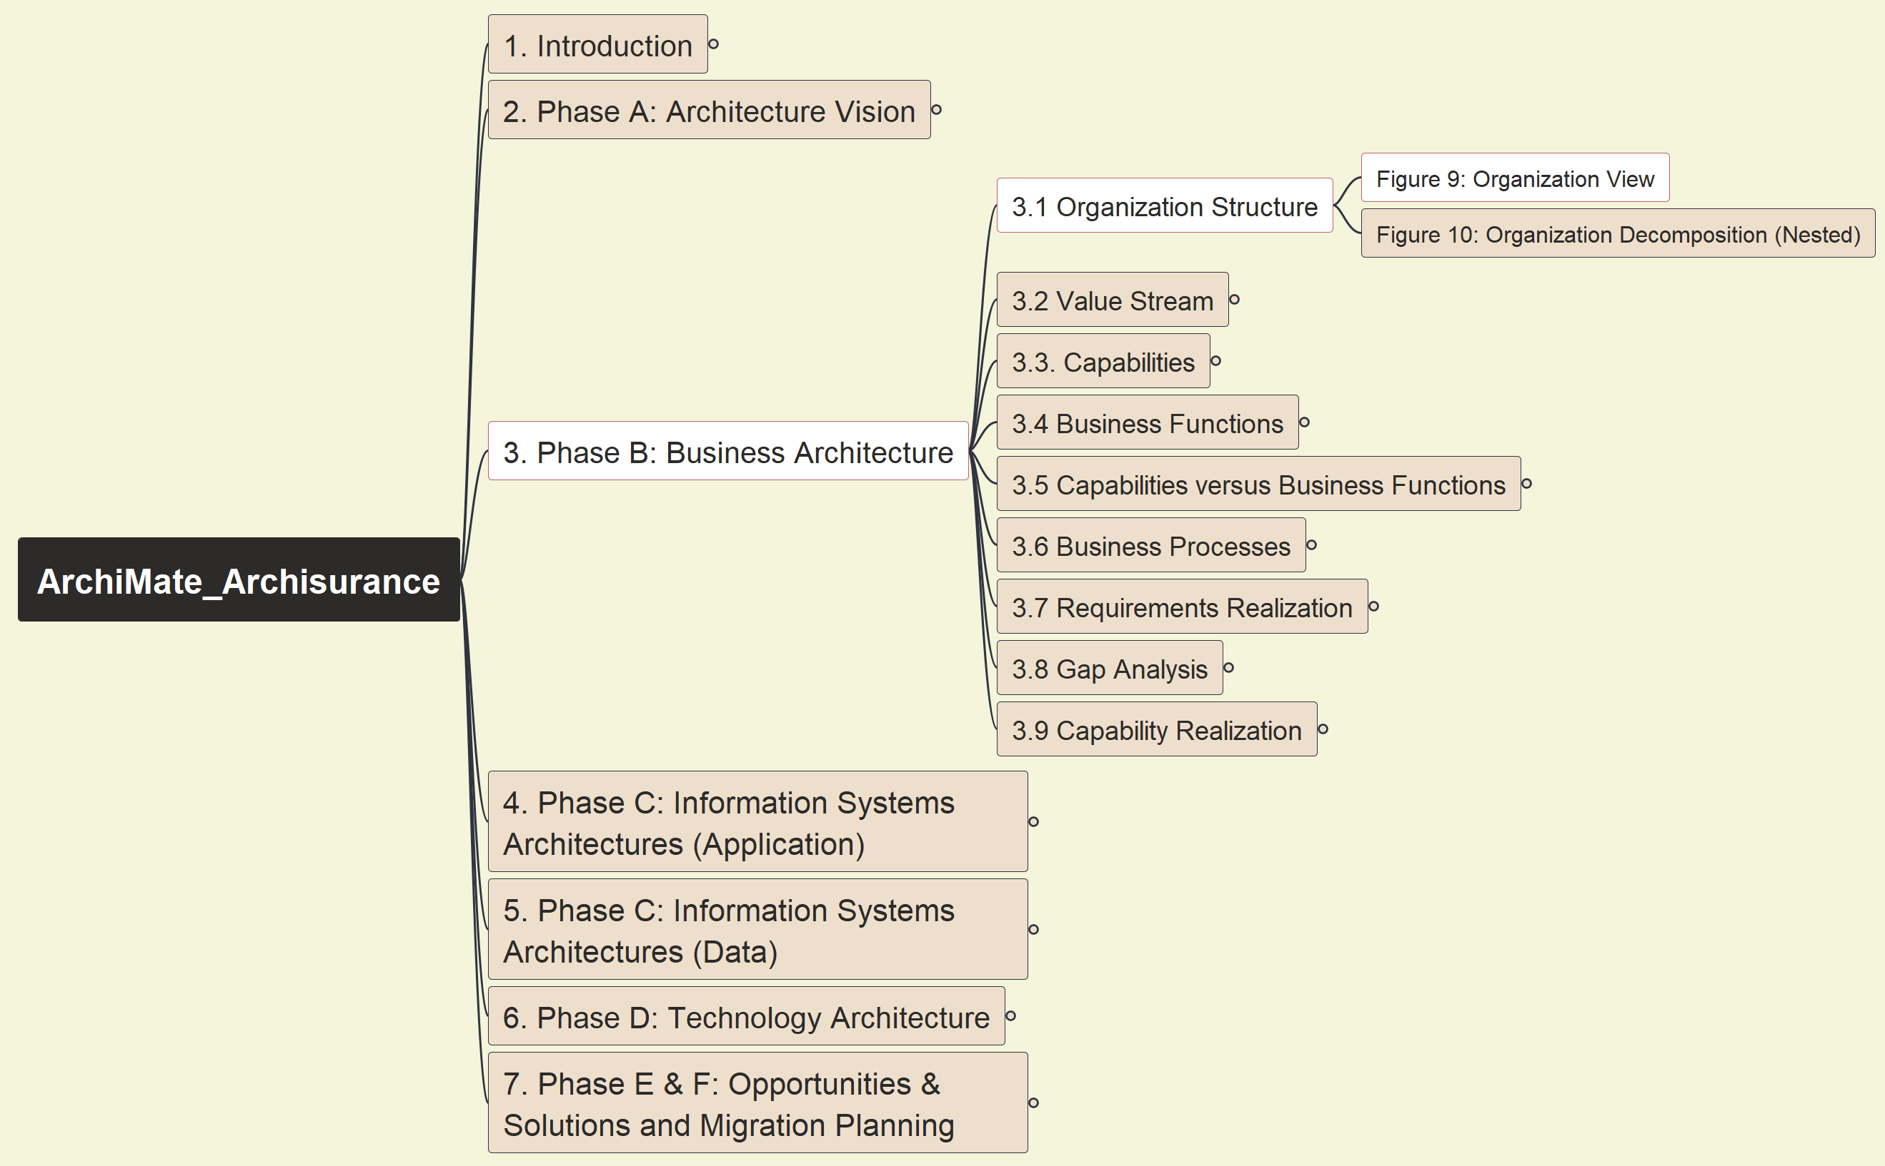
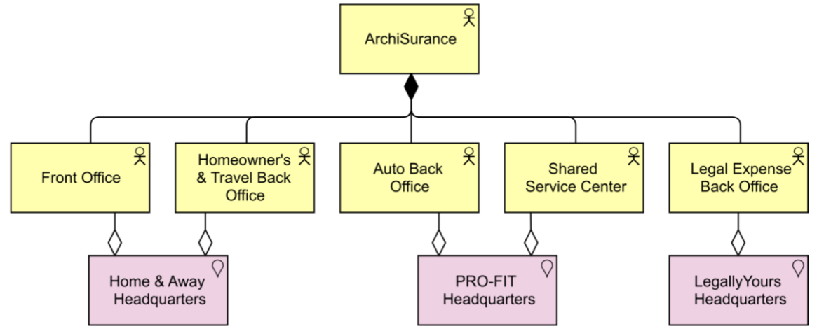
Phase B: Business Architecture - Figure 09: Organization View
ArchiSurance 2025
011

Slide 17
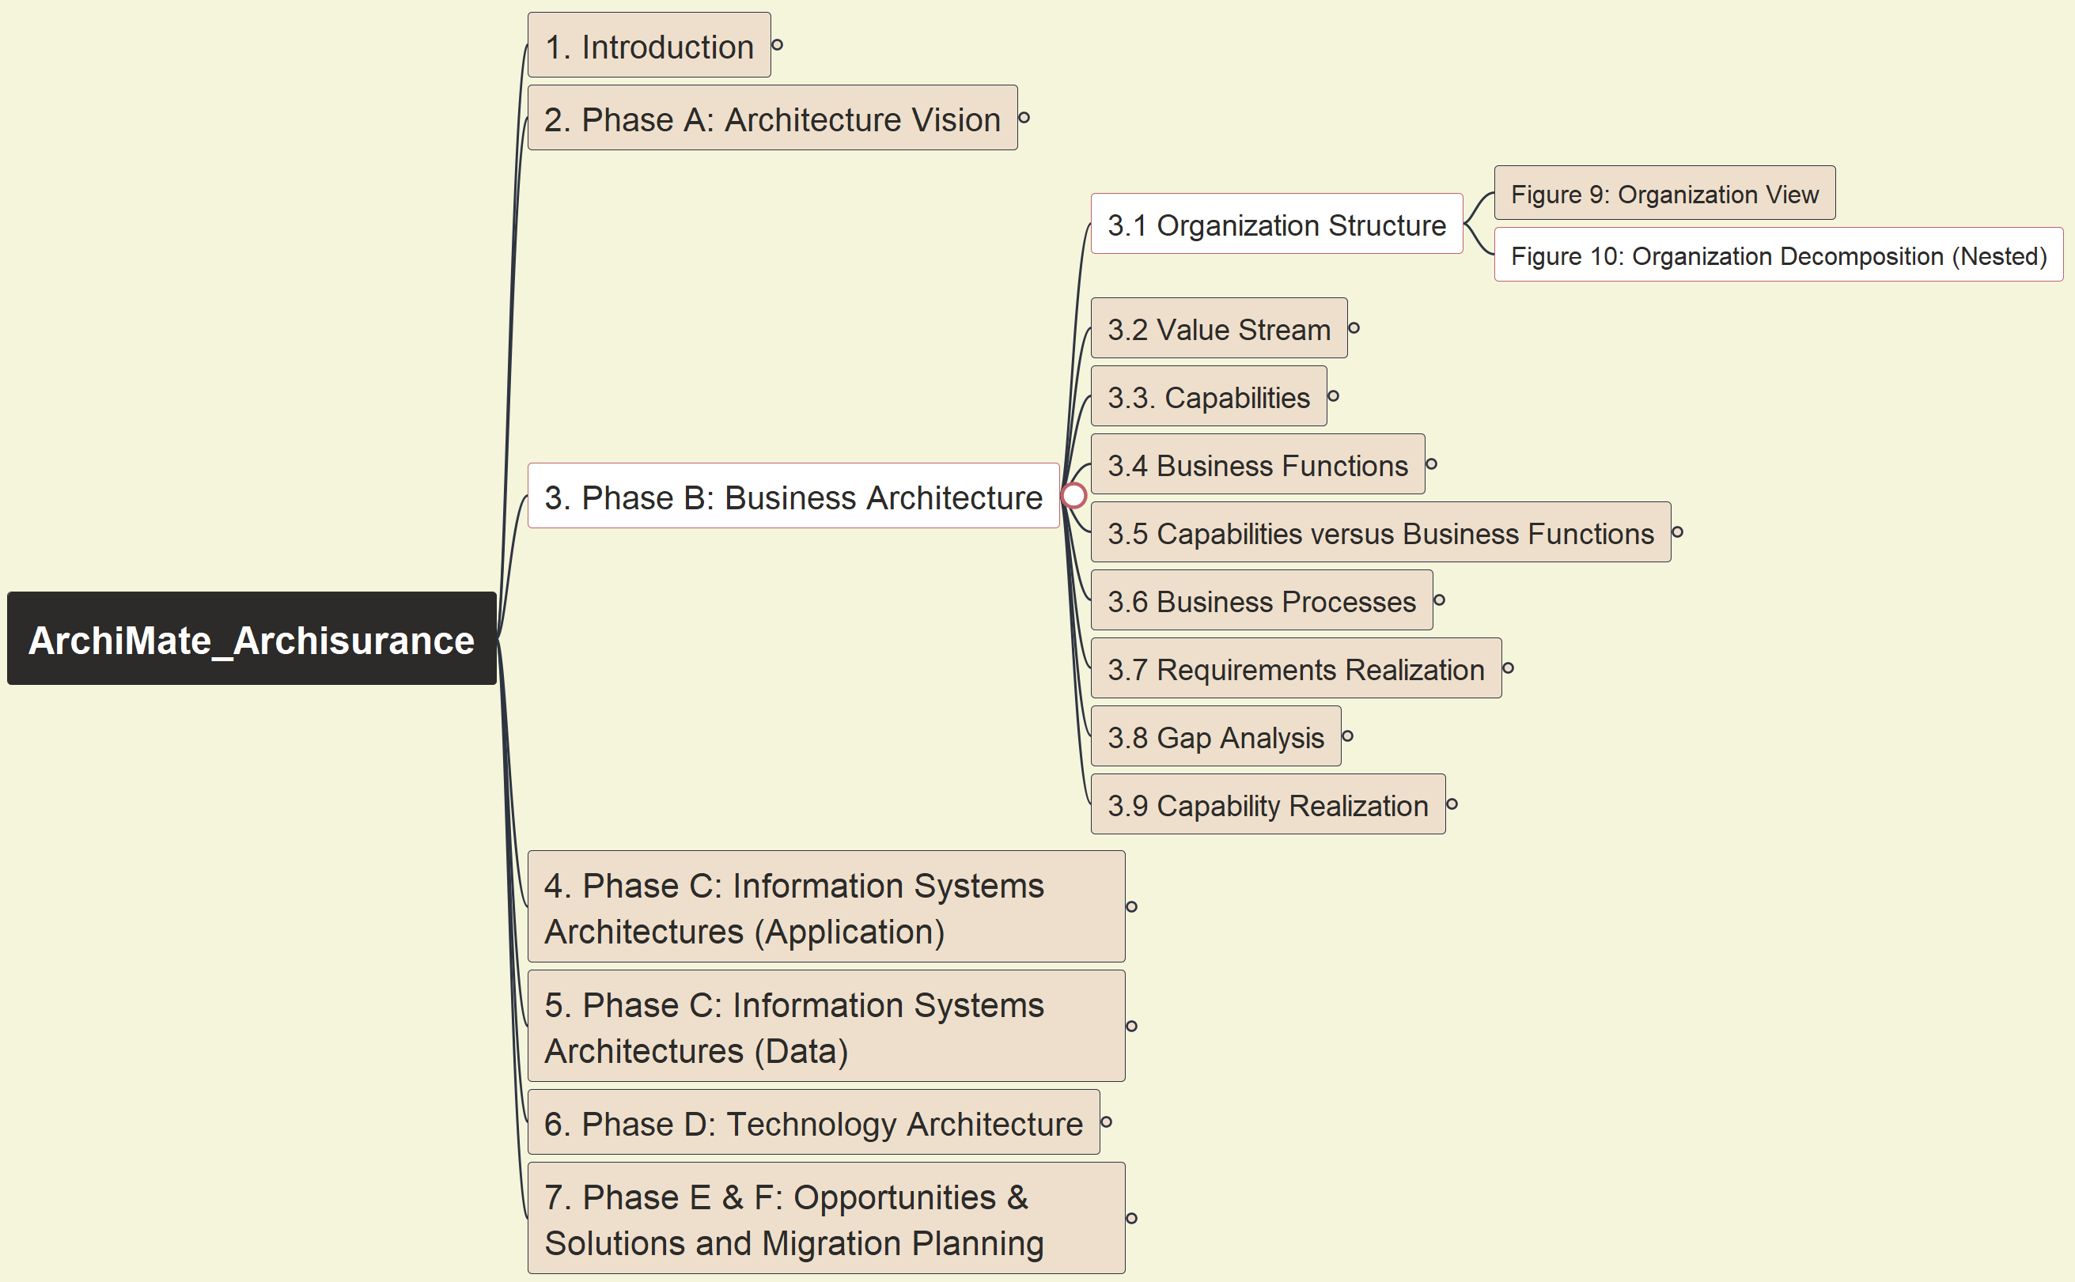
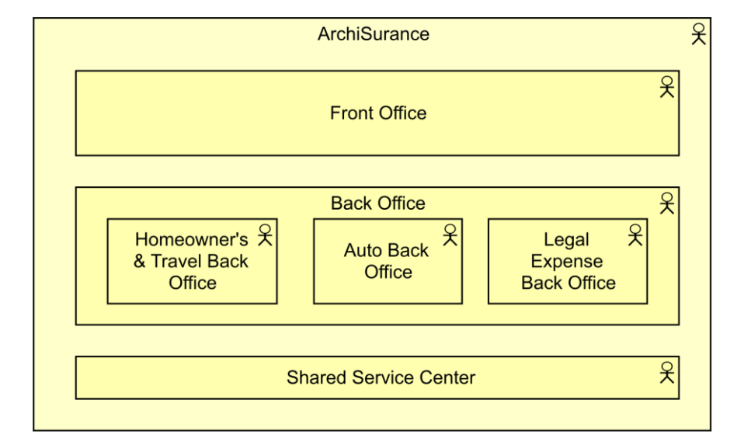
Phase B: Business Architecture - Figure 10: Organization Decomposition (Nested)
ArchiSurance 2025
012

Slide 18
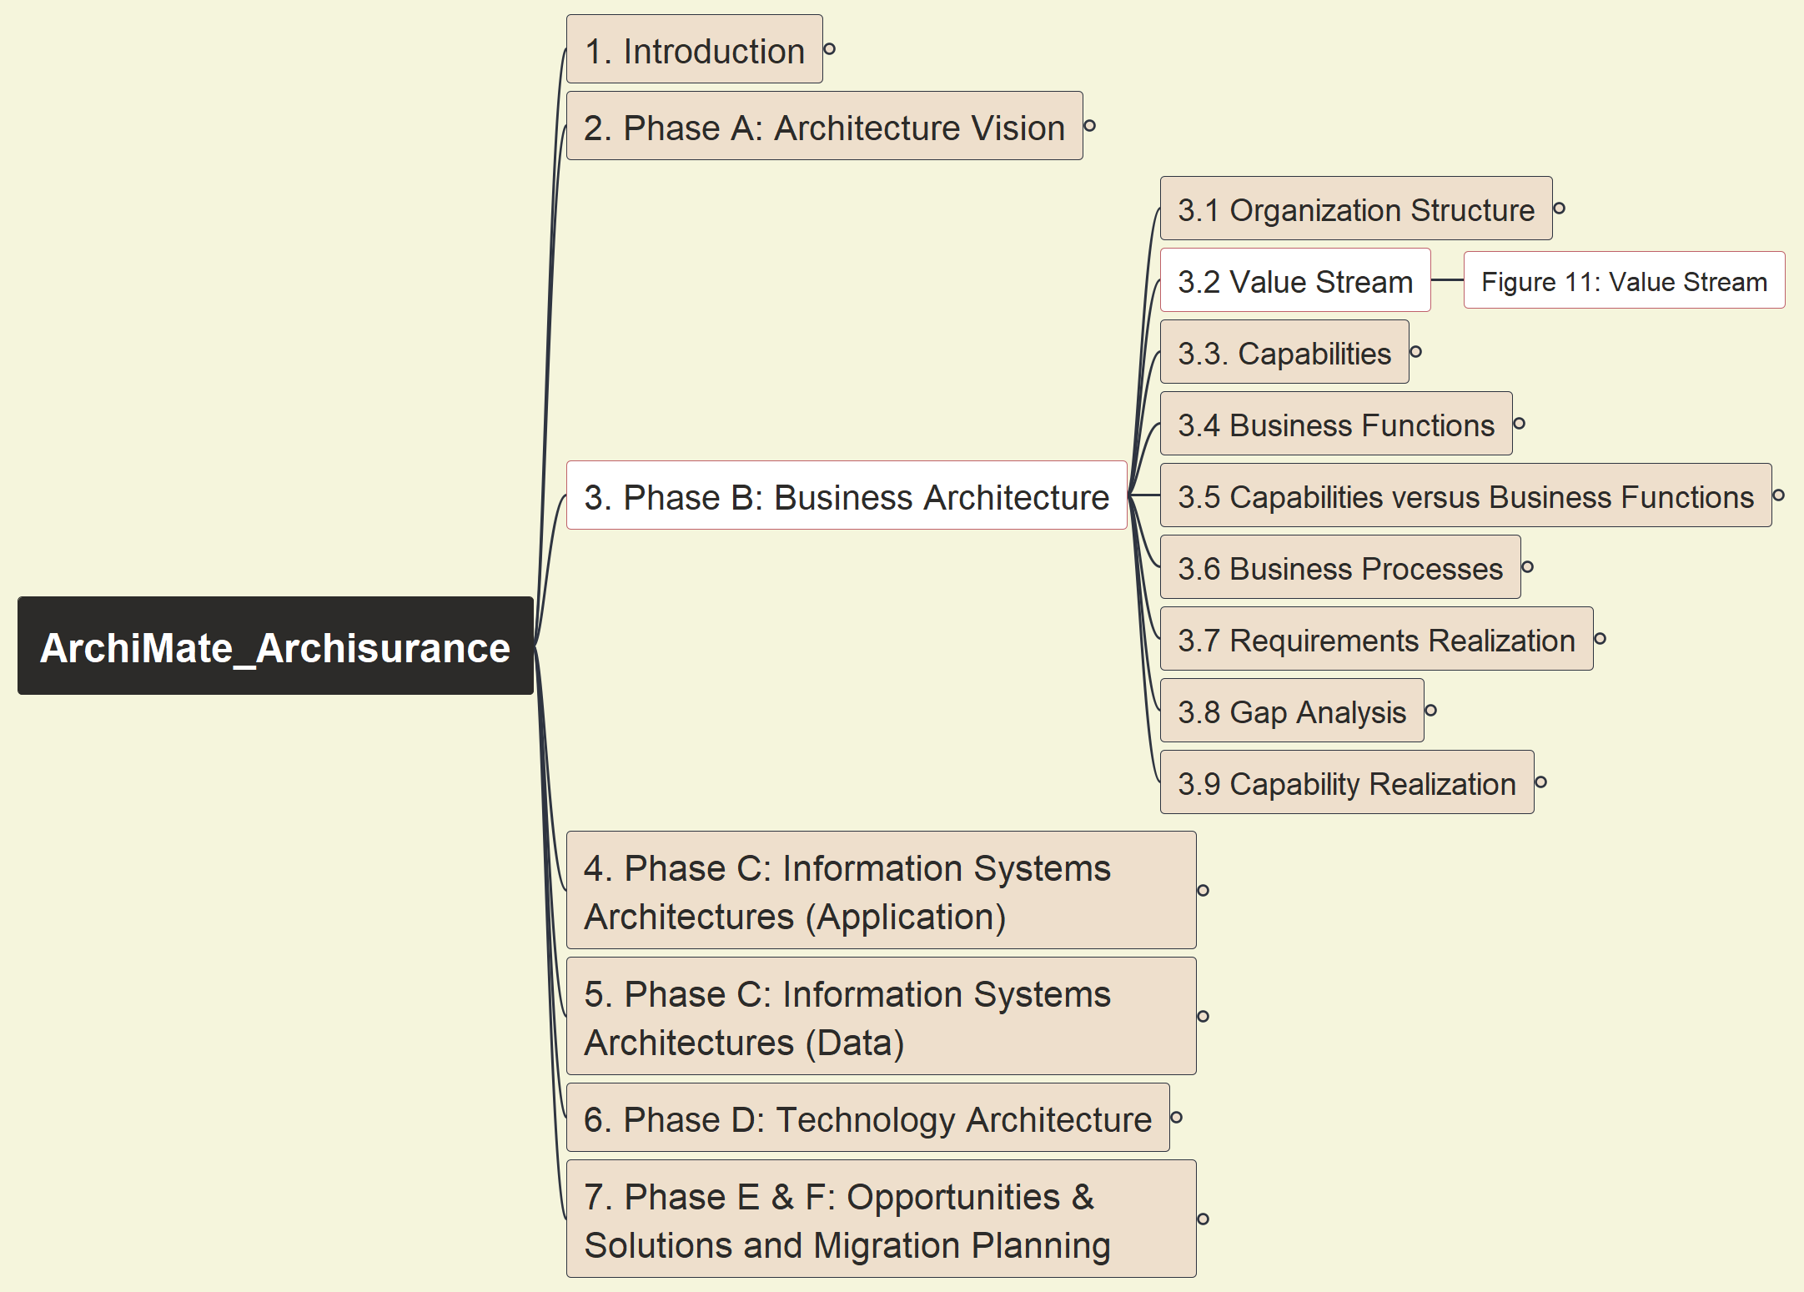
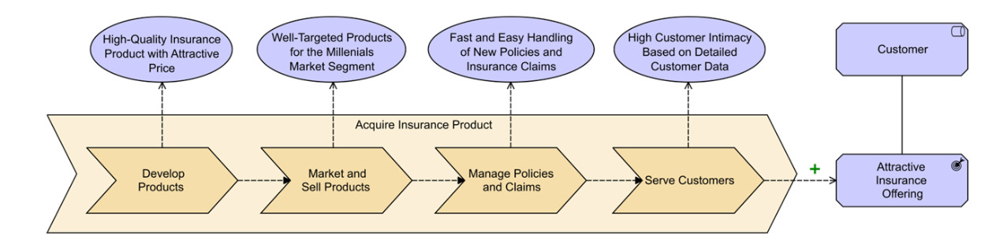
Phase B: Business Architecture - Figure 11: Value Stream
ArchiSurance 2025
013

Slide 19
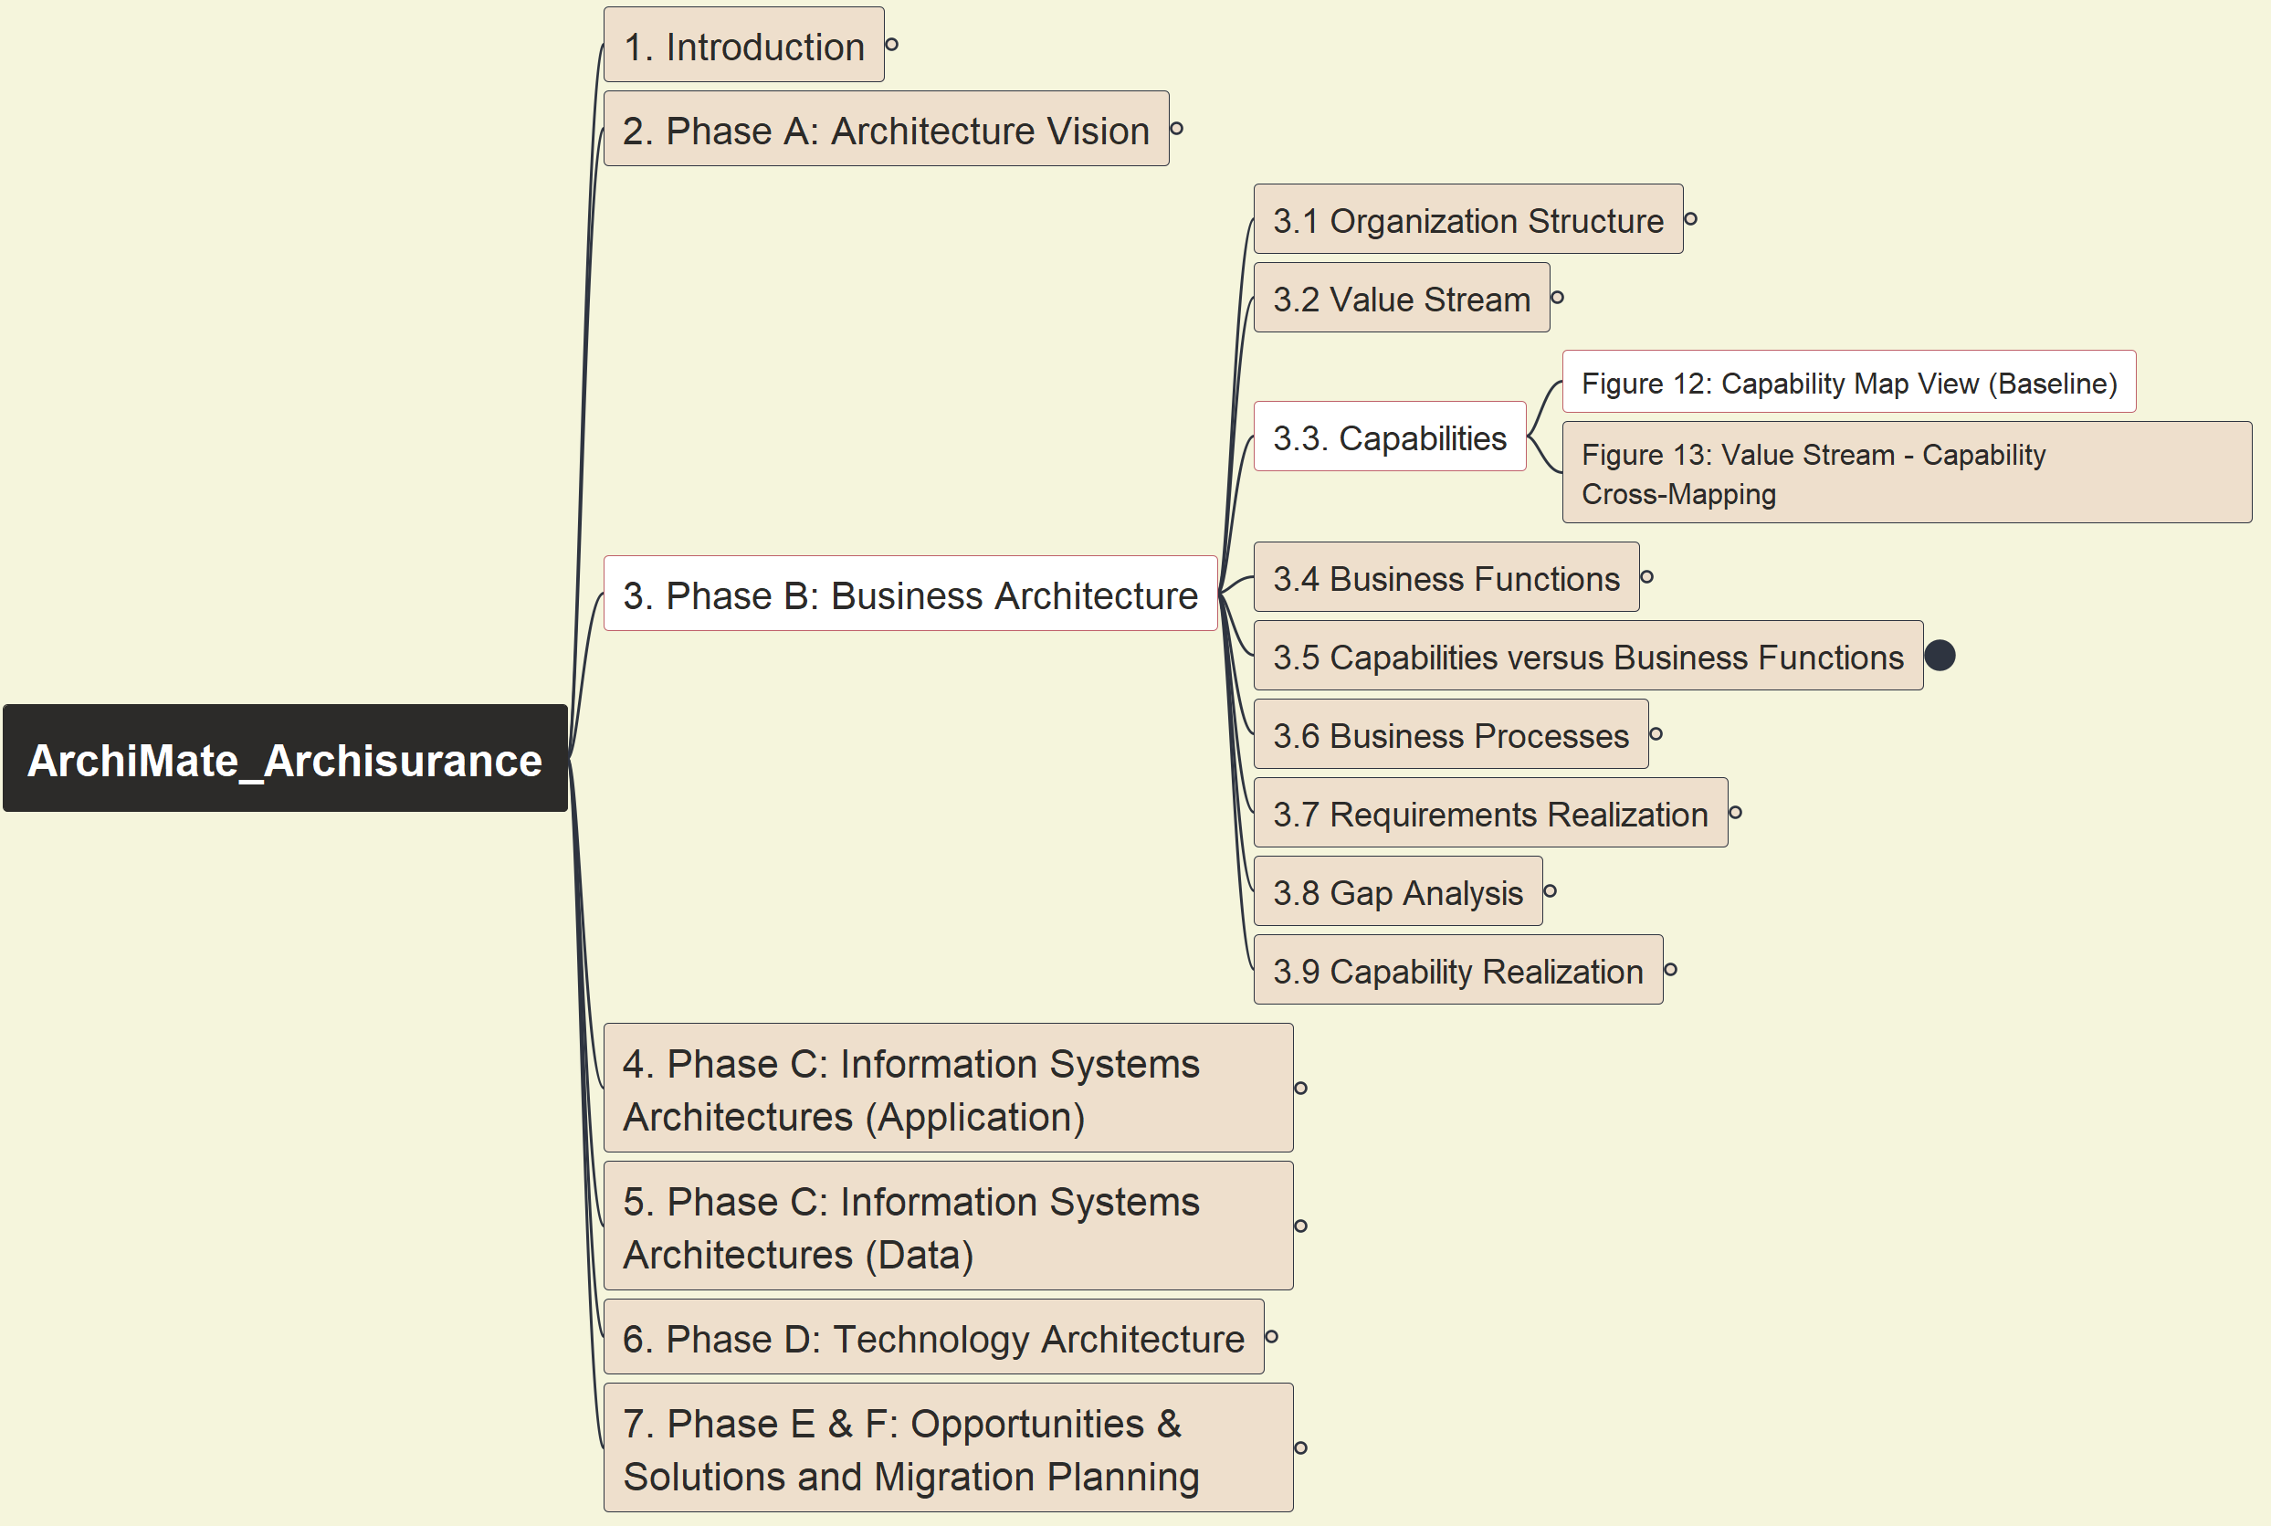
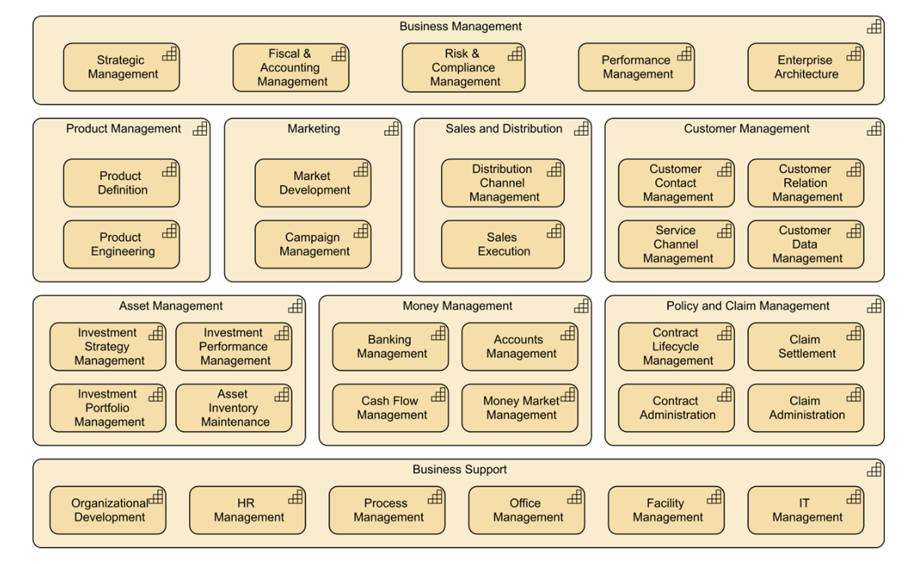
Phase B: Business Architecture - Figure 12: Capability Map View (Baseline)
ArchiSurance 2025
014

Slide 20
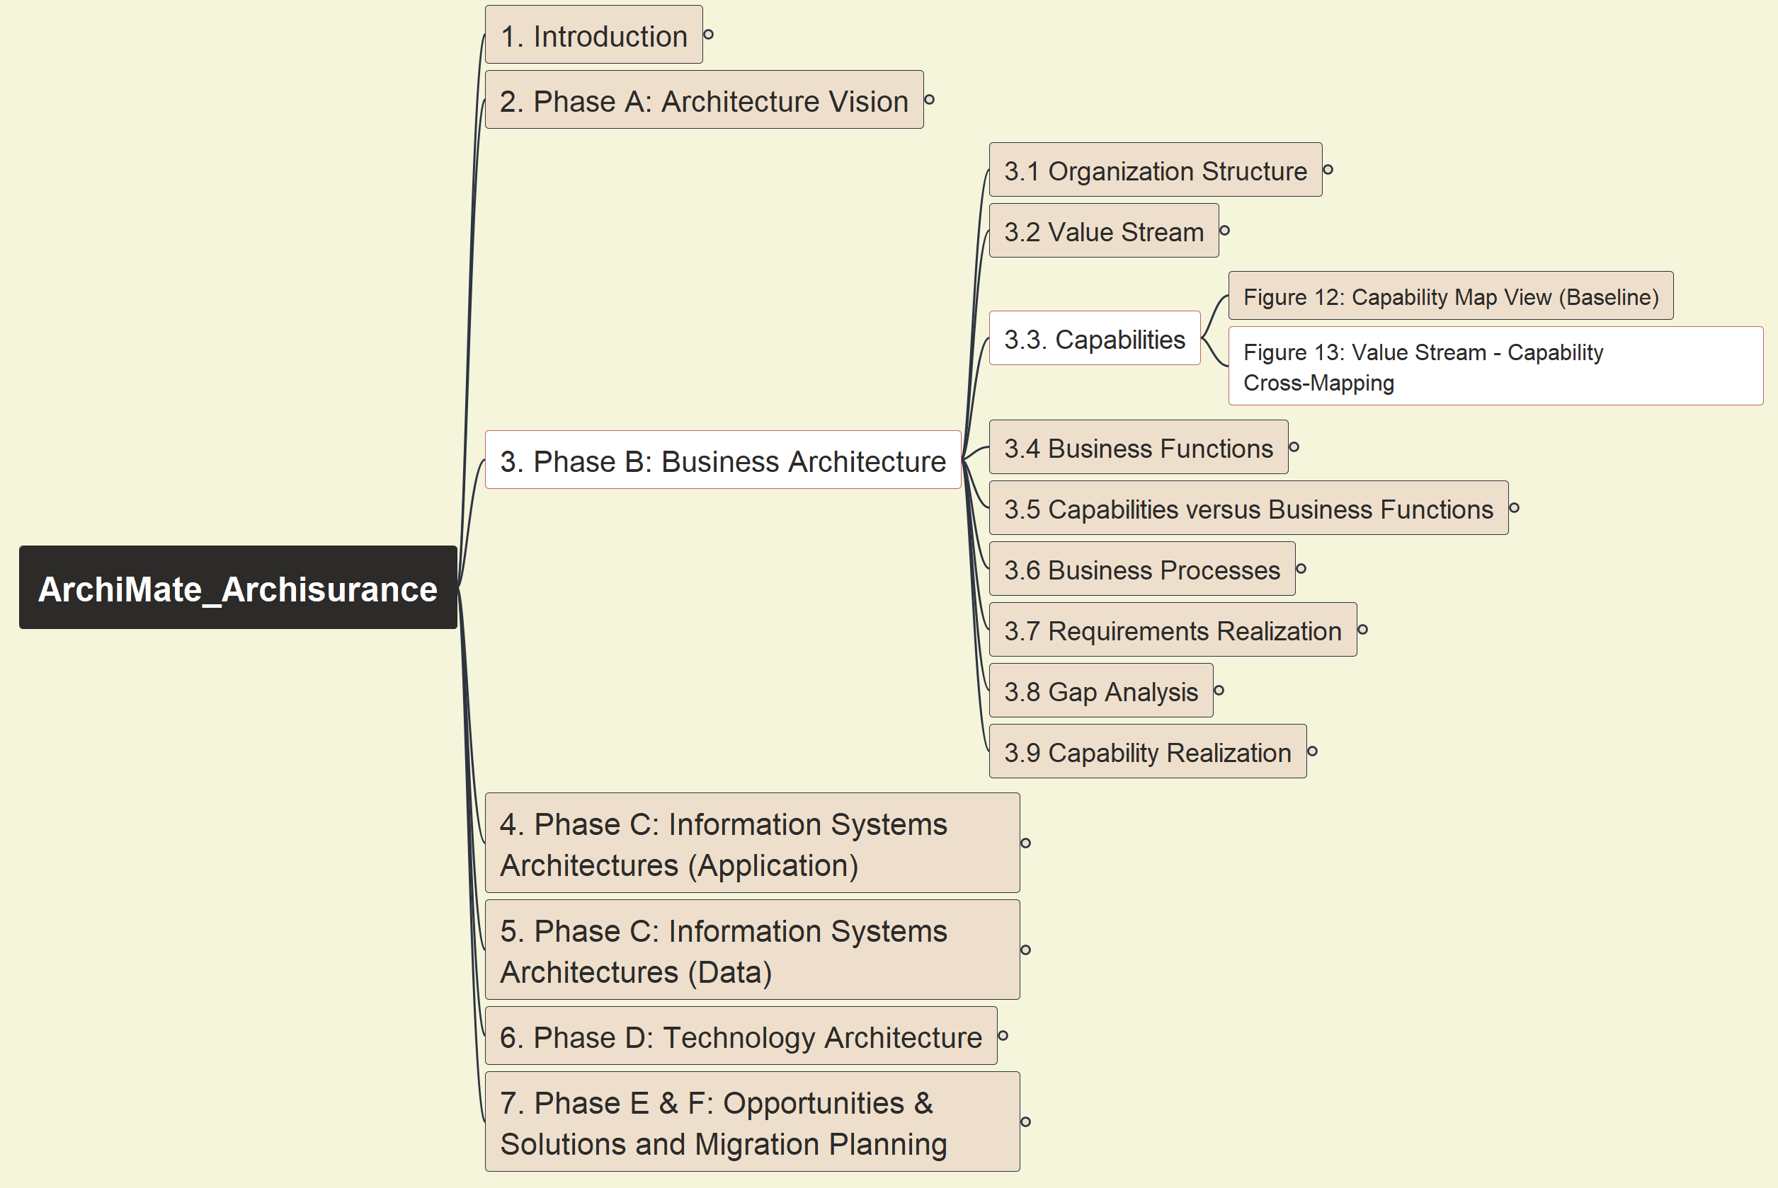
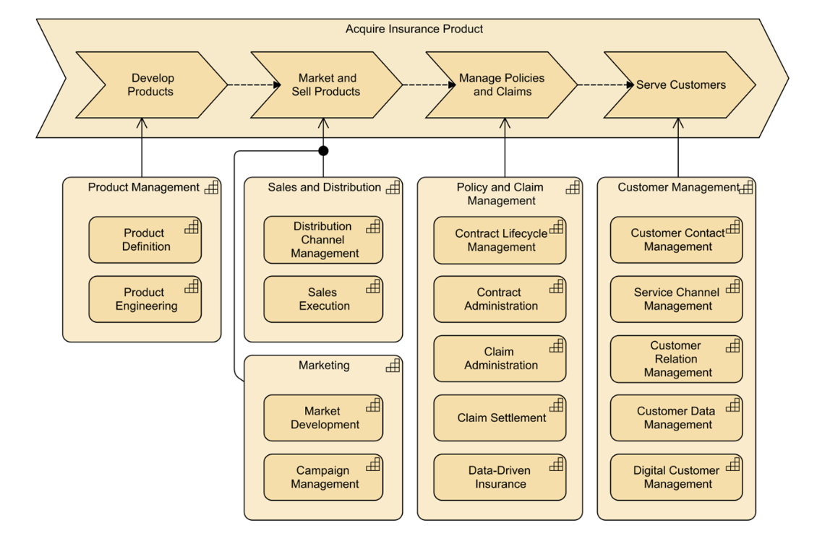
Phase B: Business Architecture - Figure 13: Value Stream – Capability Cross-Mapping
ArchiSurance 2025
015

Slide 21
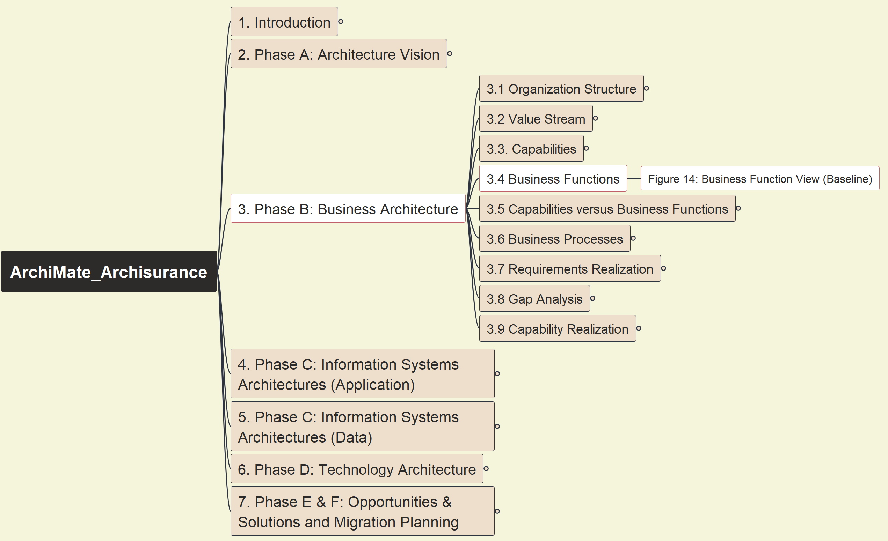
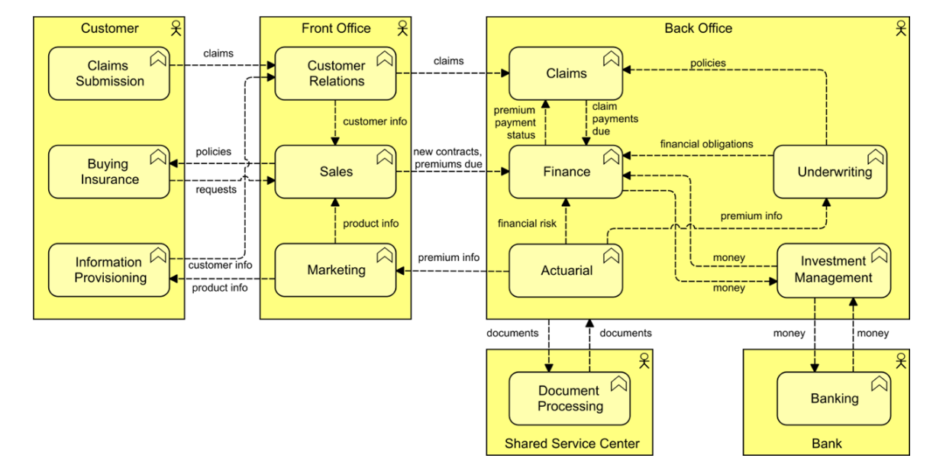
Phase B: Business Architecture - Figure 14: Business Function View (Baseline)
ArchiSurance 2025
016

Slide 22
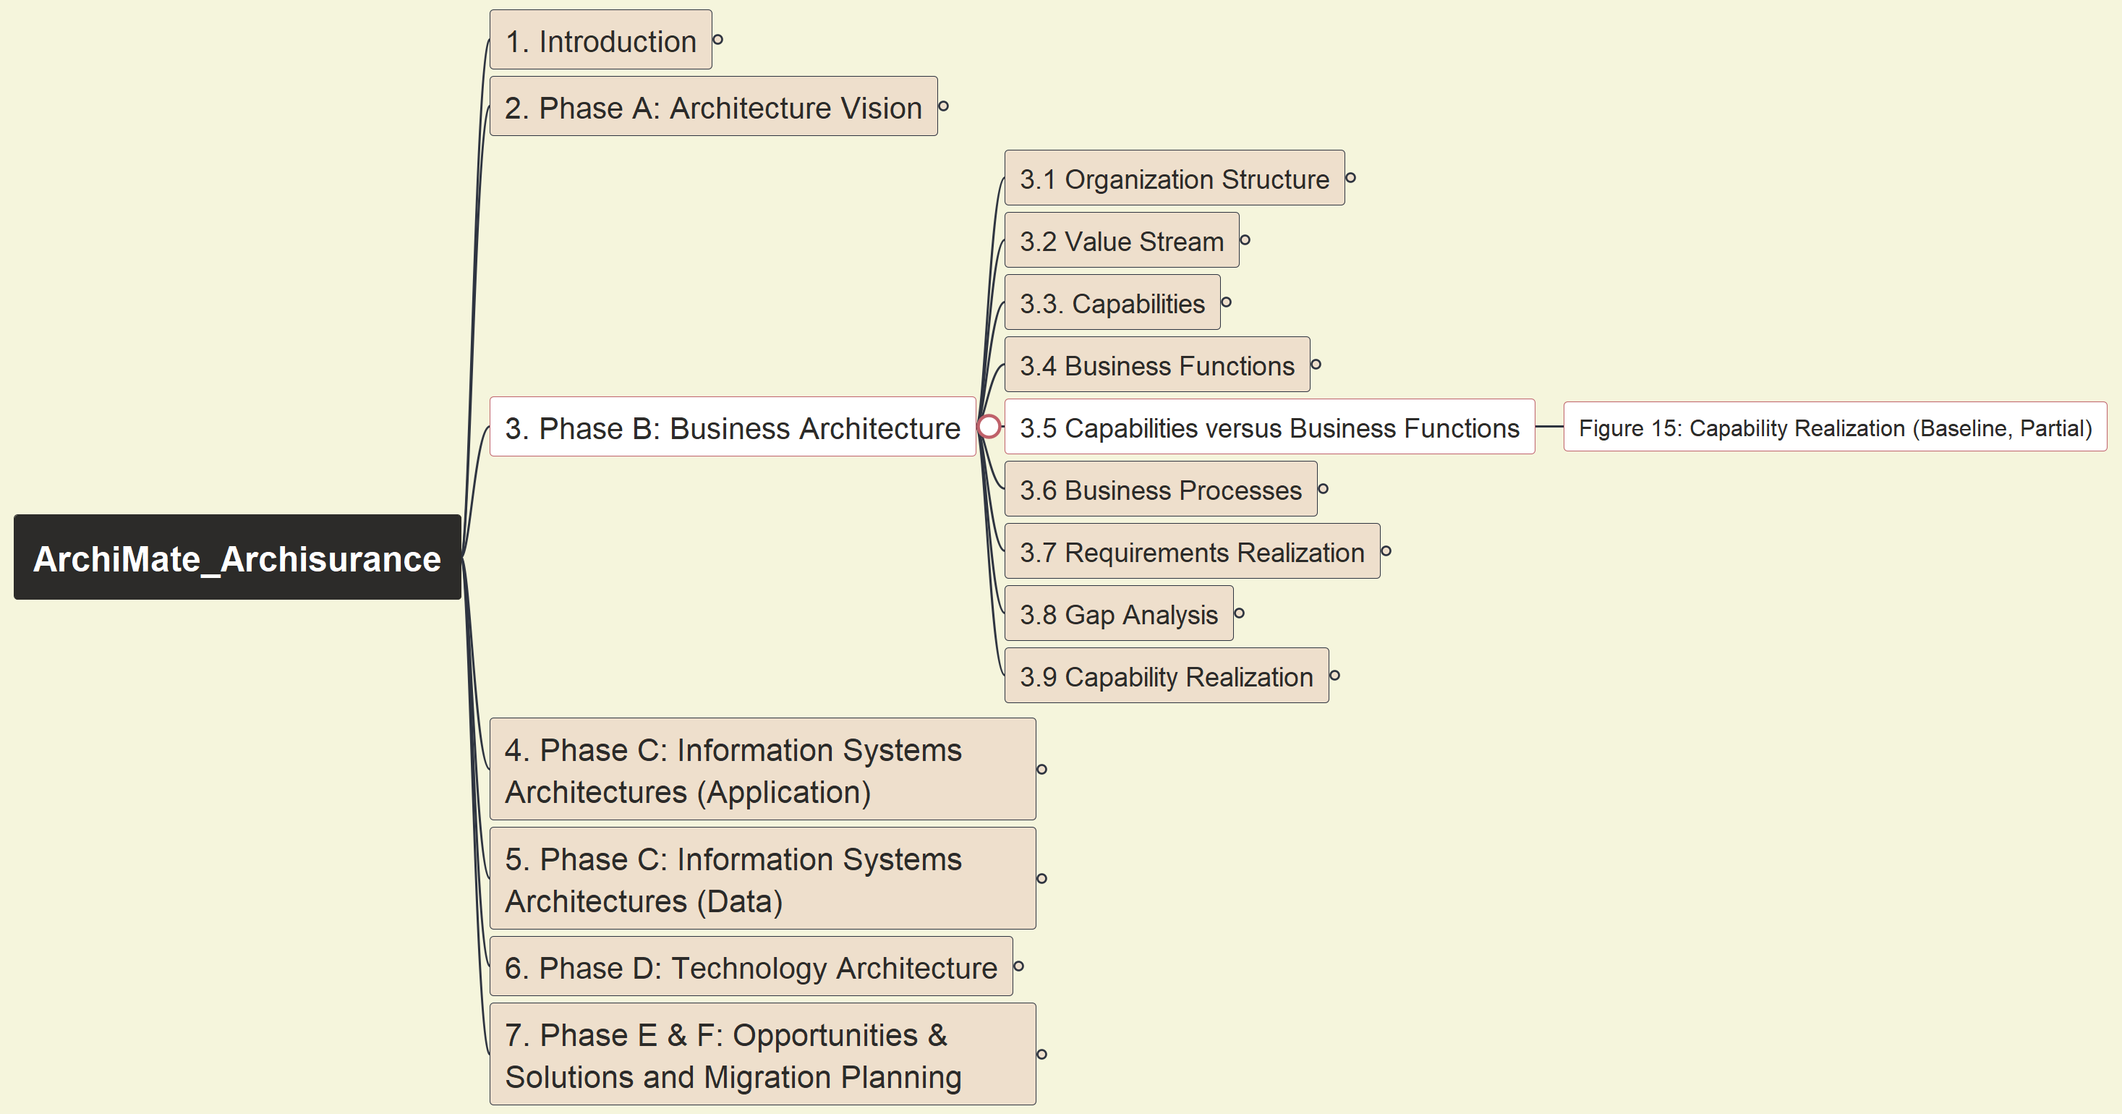
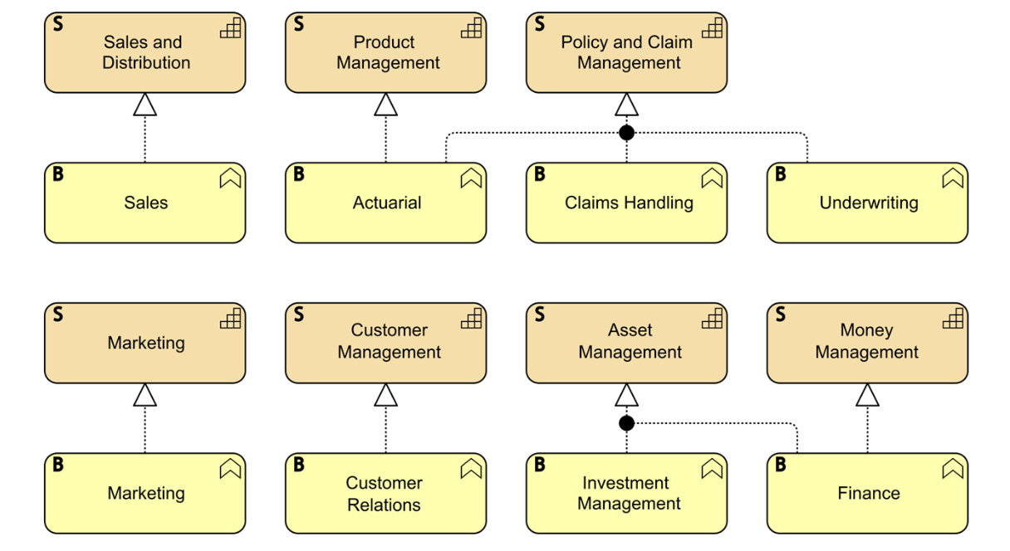
Phase B: Business Architecture - Figure 15: Capability Realization (Baseline, Partial)
ArchiSurance 2025
017

Slide 23
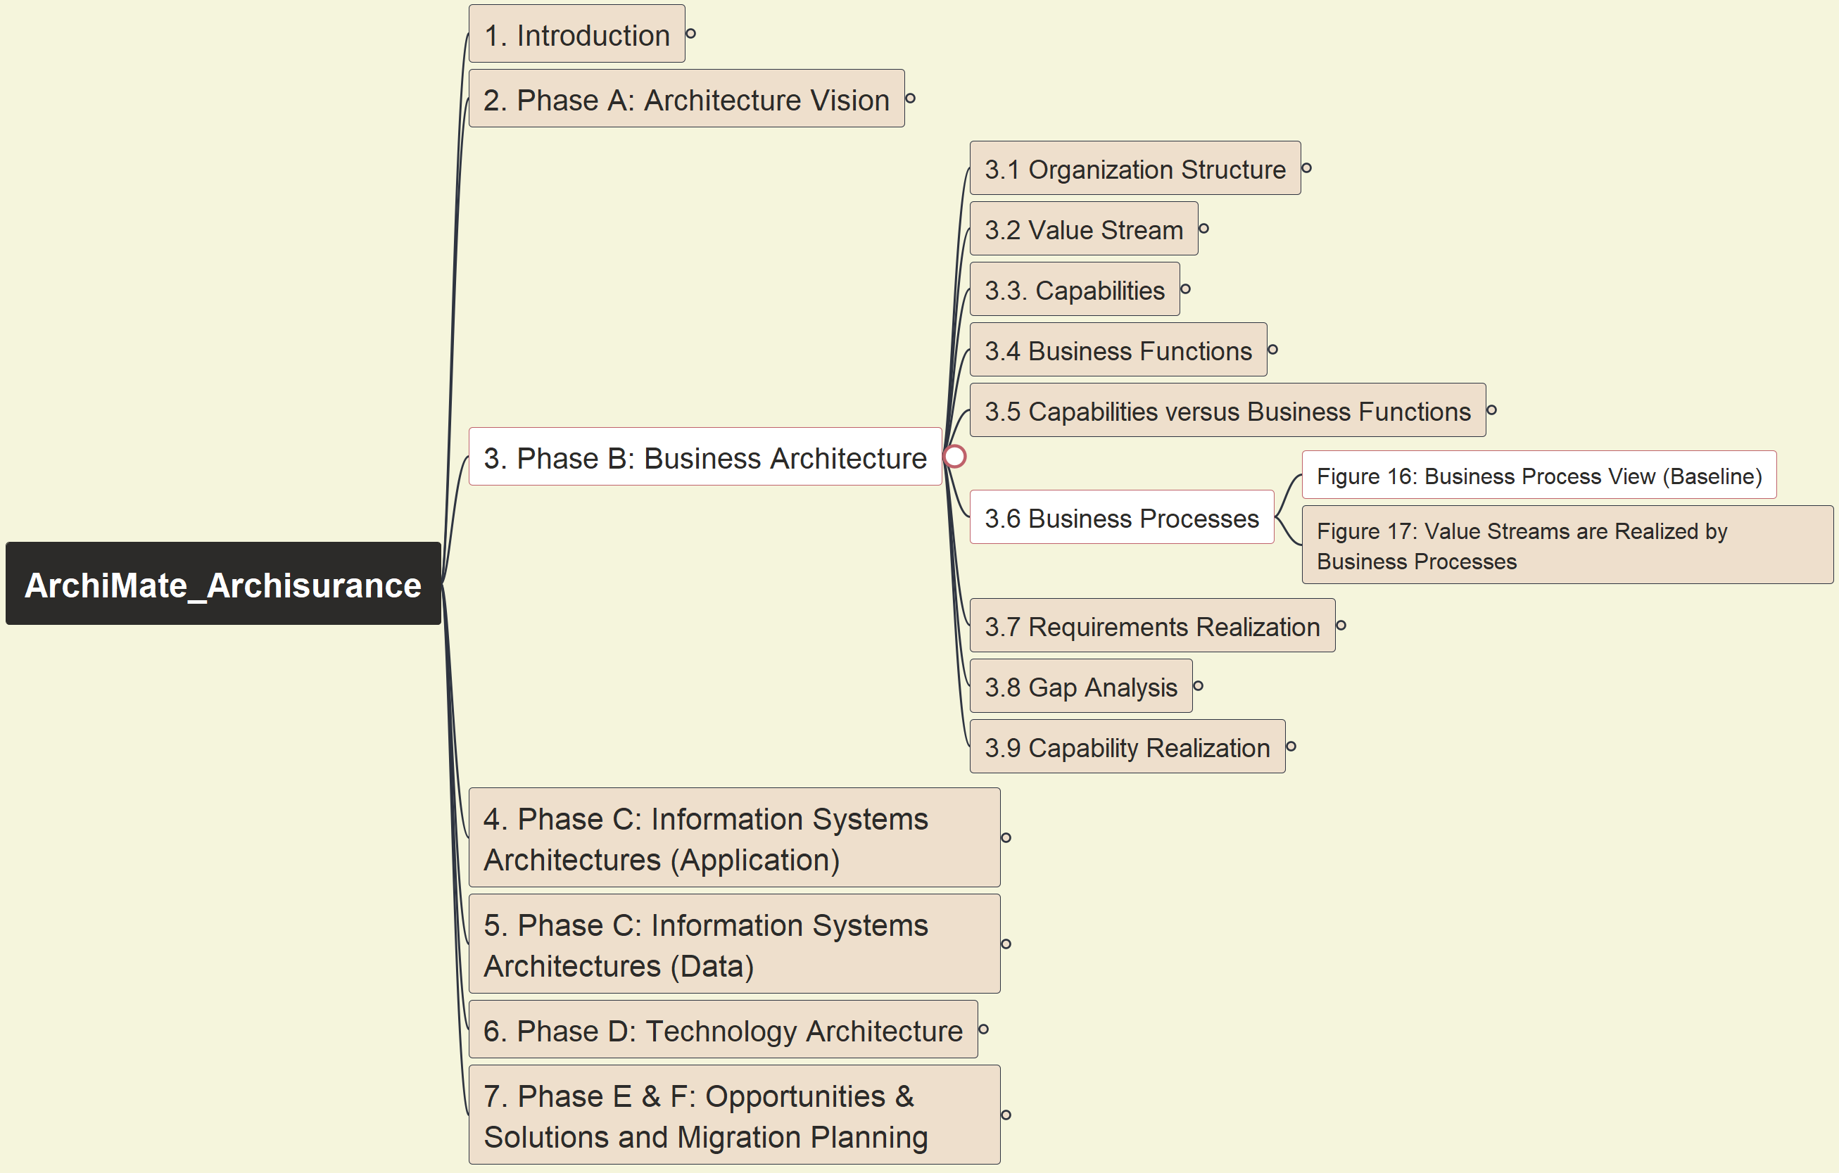
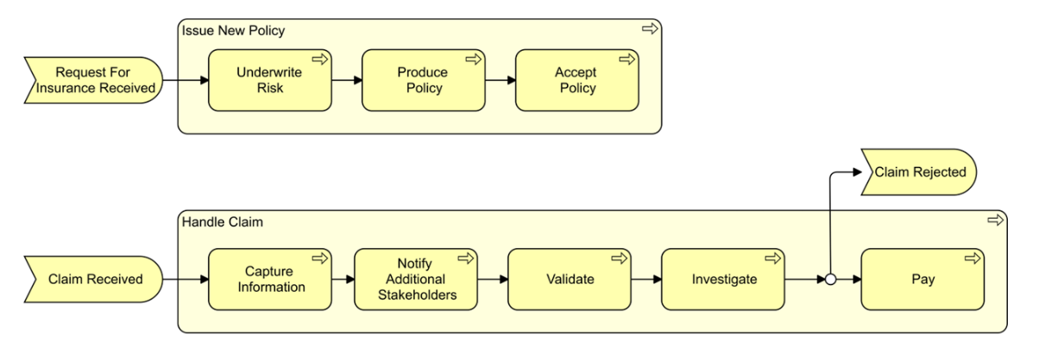
Phase B: Business Architecture - Figure 16: Business Process View (Baseline)
ArchiSurance 2025
018

Slide 24
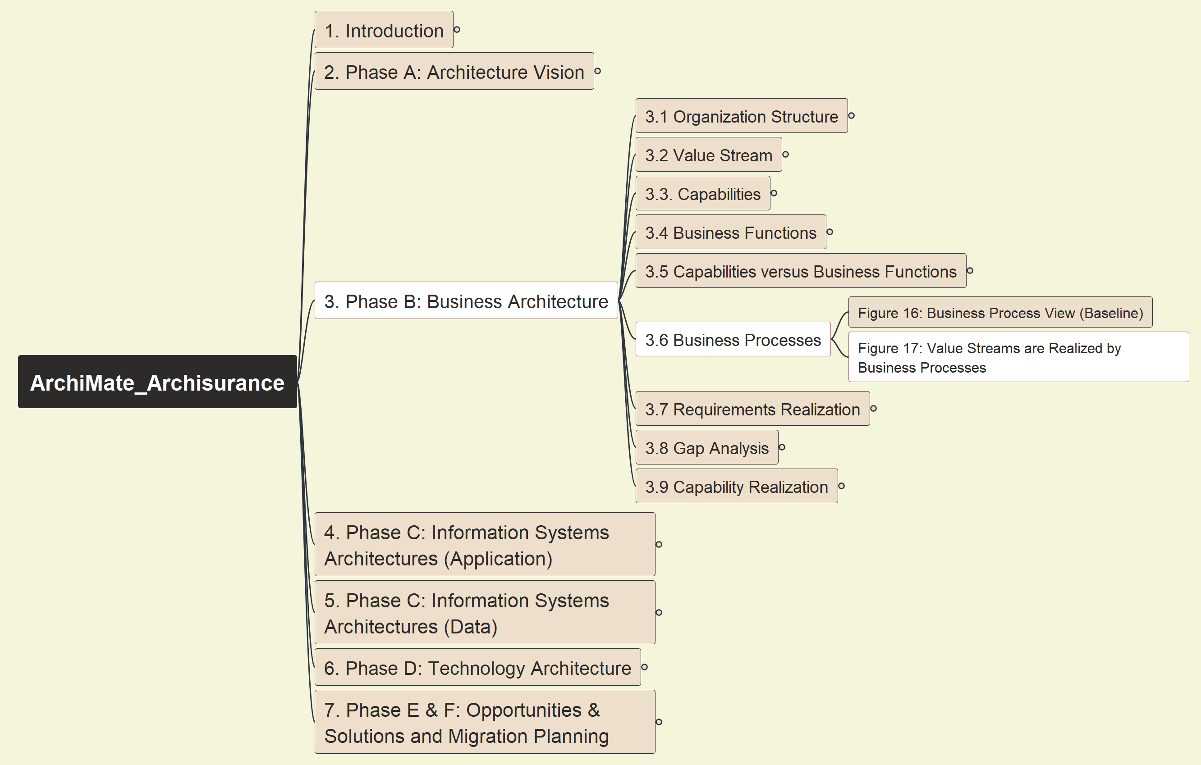
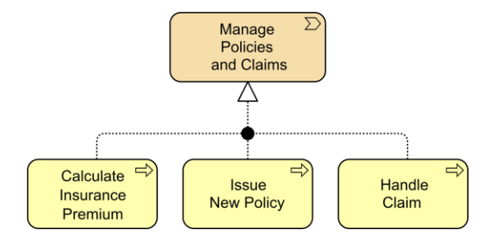
Phase B: Business Architecture - Figure 17: Value Stream are Realized by Business Processes
ArchiSurance 2025
019

Slide 25
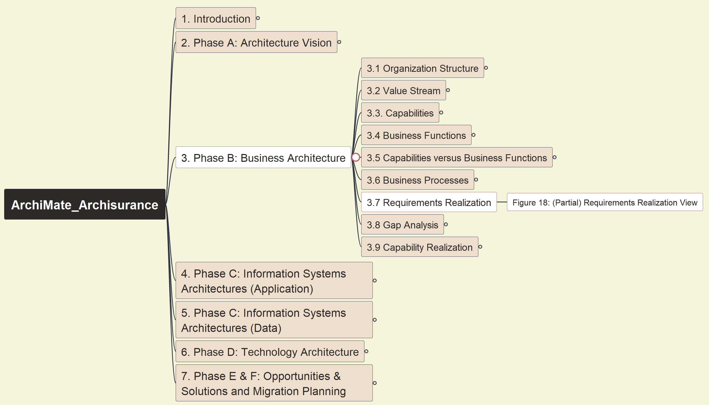
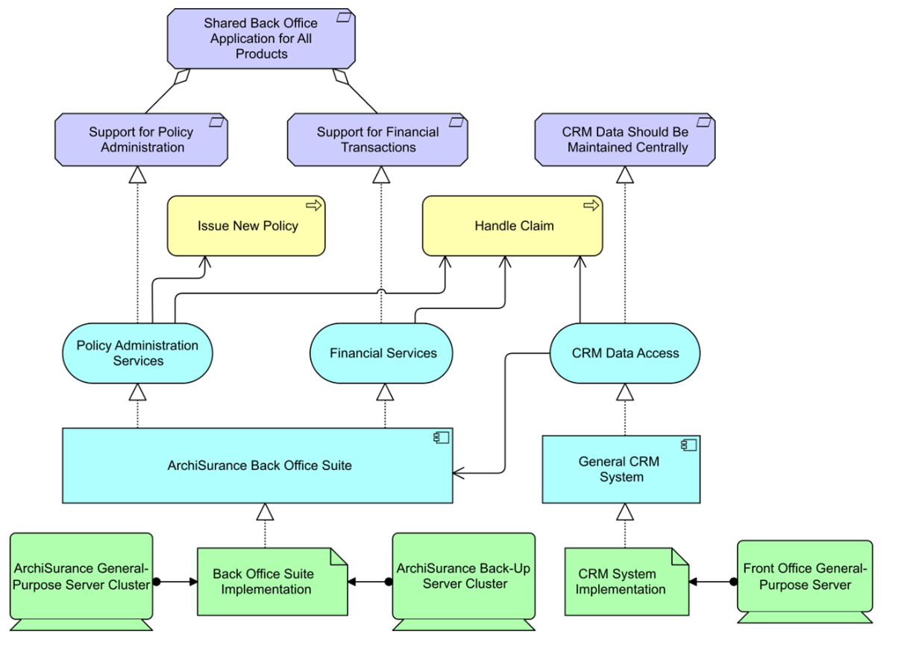
Phase B: Business Architecture - Figure 18: (Partial) Requirements Realization View
ArchiSurance 2025
020

Slide 26
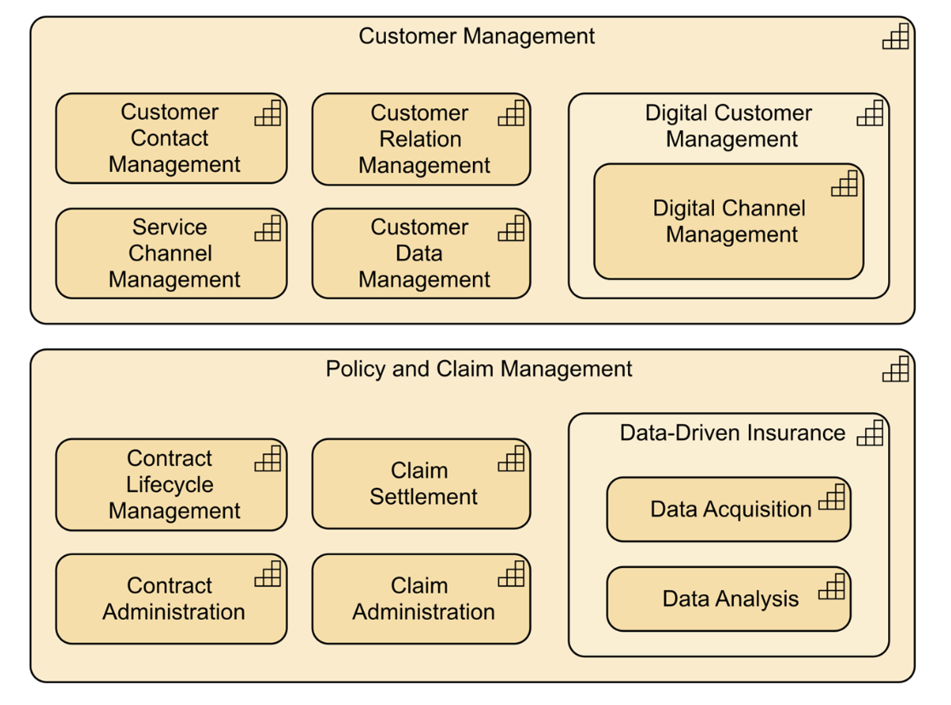
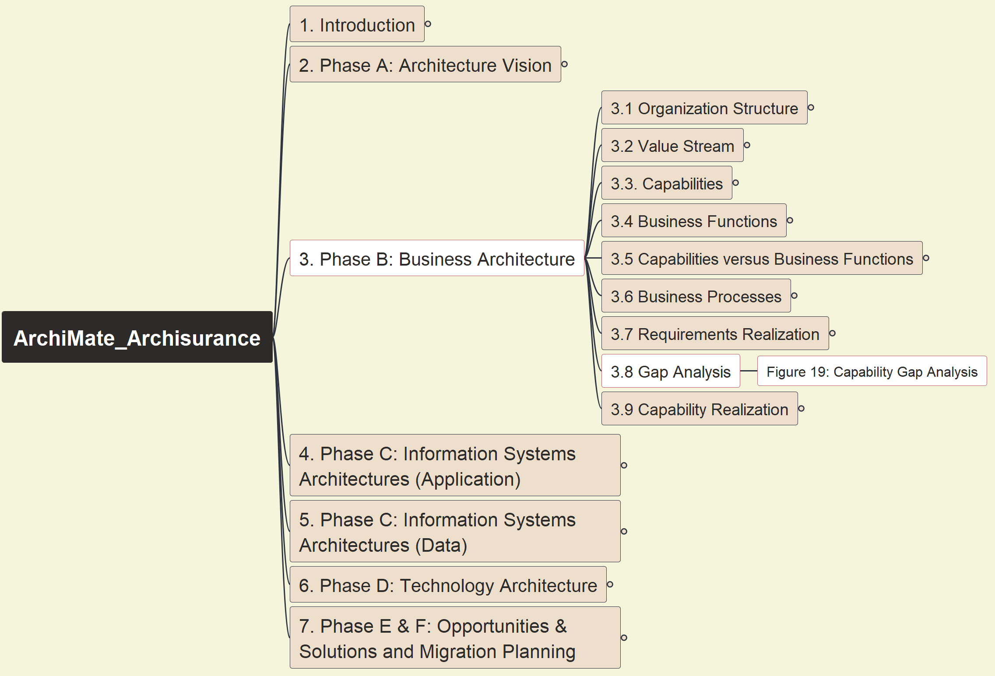
Phase B: Business Architecture - Figure 19: Capability Gap Analysis
ArchiSurance 2025
021

Slide 27
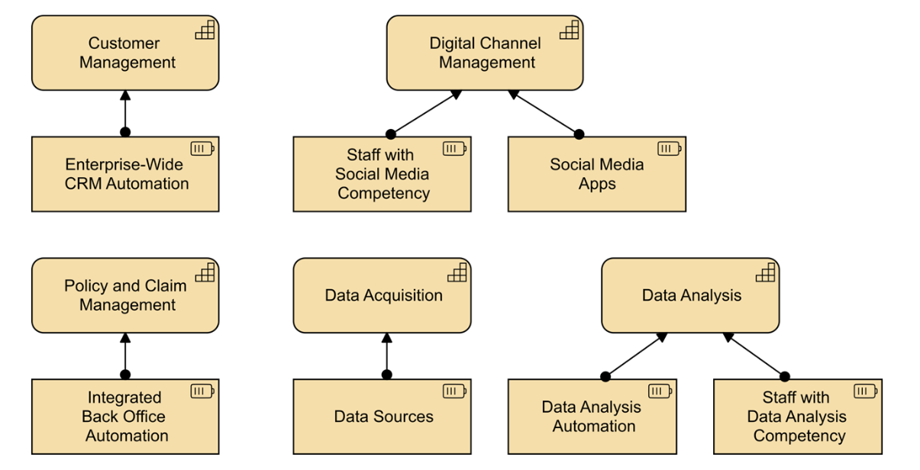
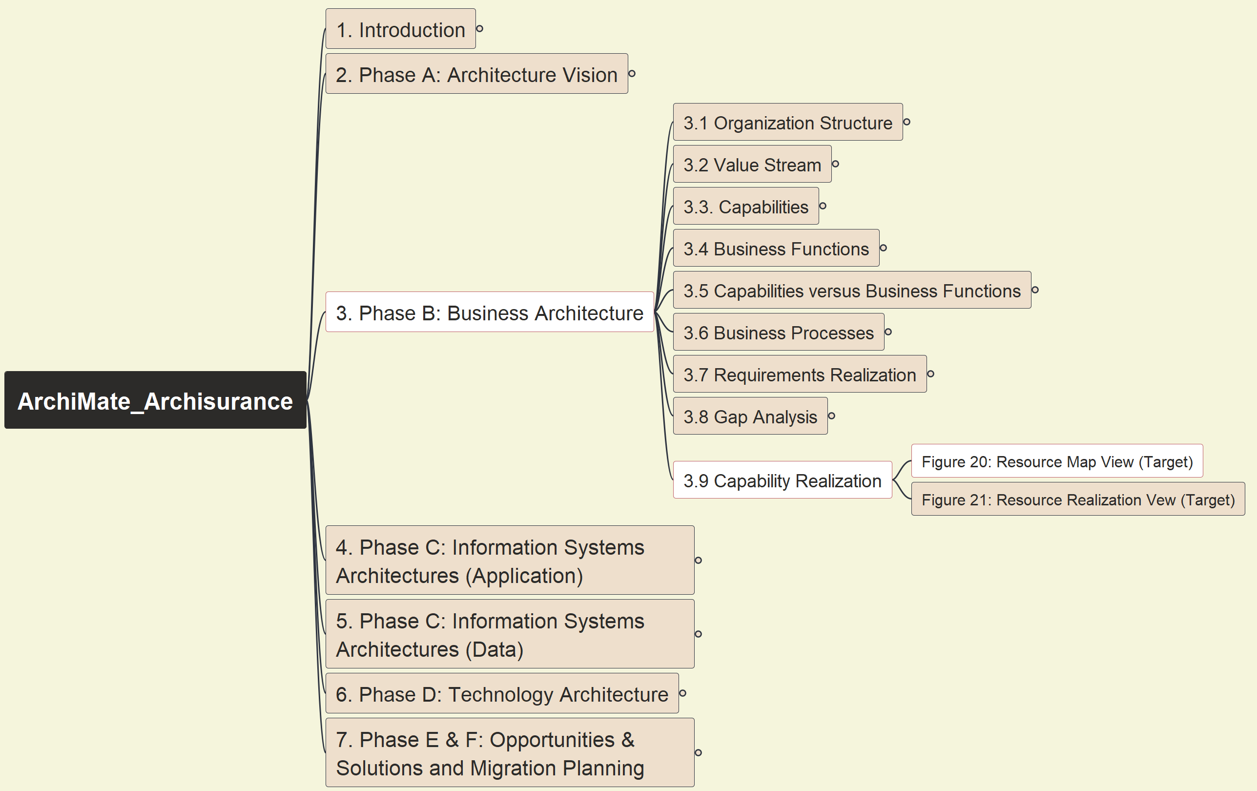
Phase B: Business Architecture - Figure 20: Resource Map View (Target)
ArchiSurance 2025
022

Slide 28
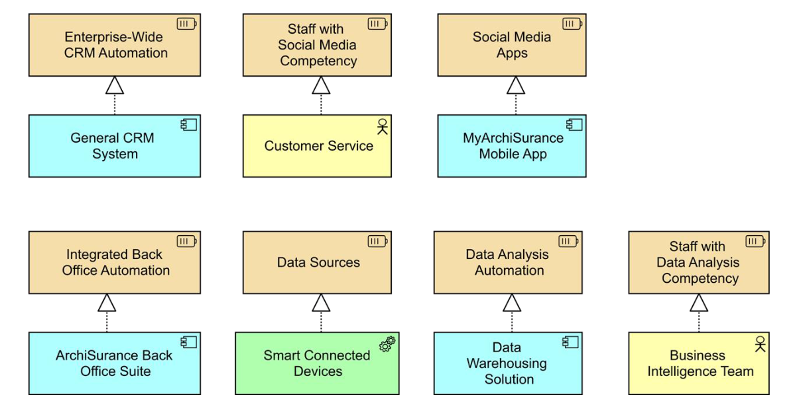
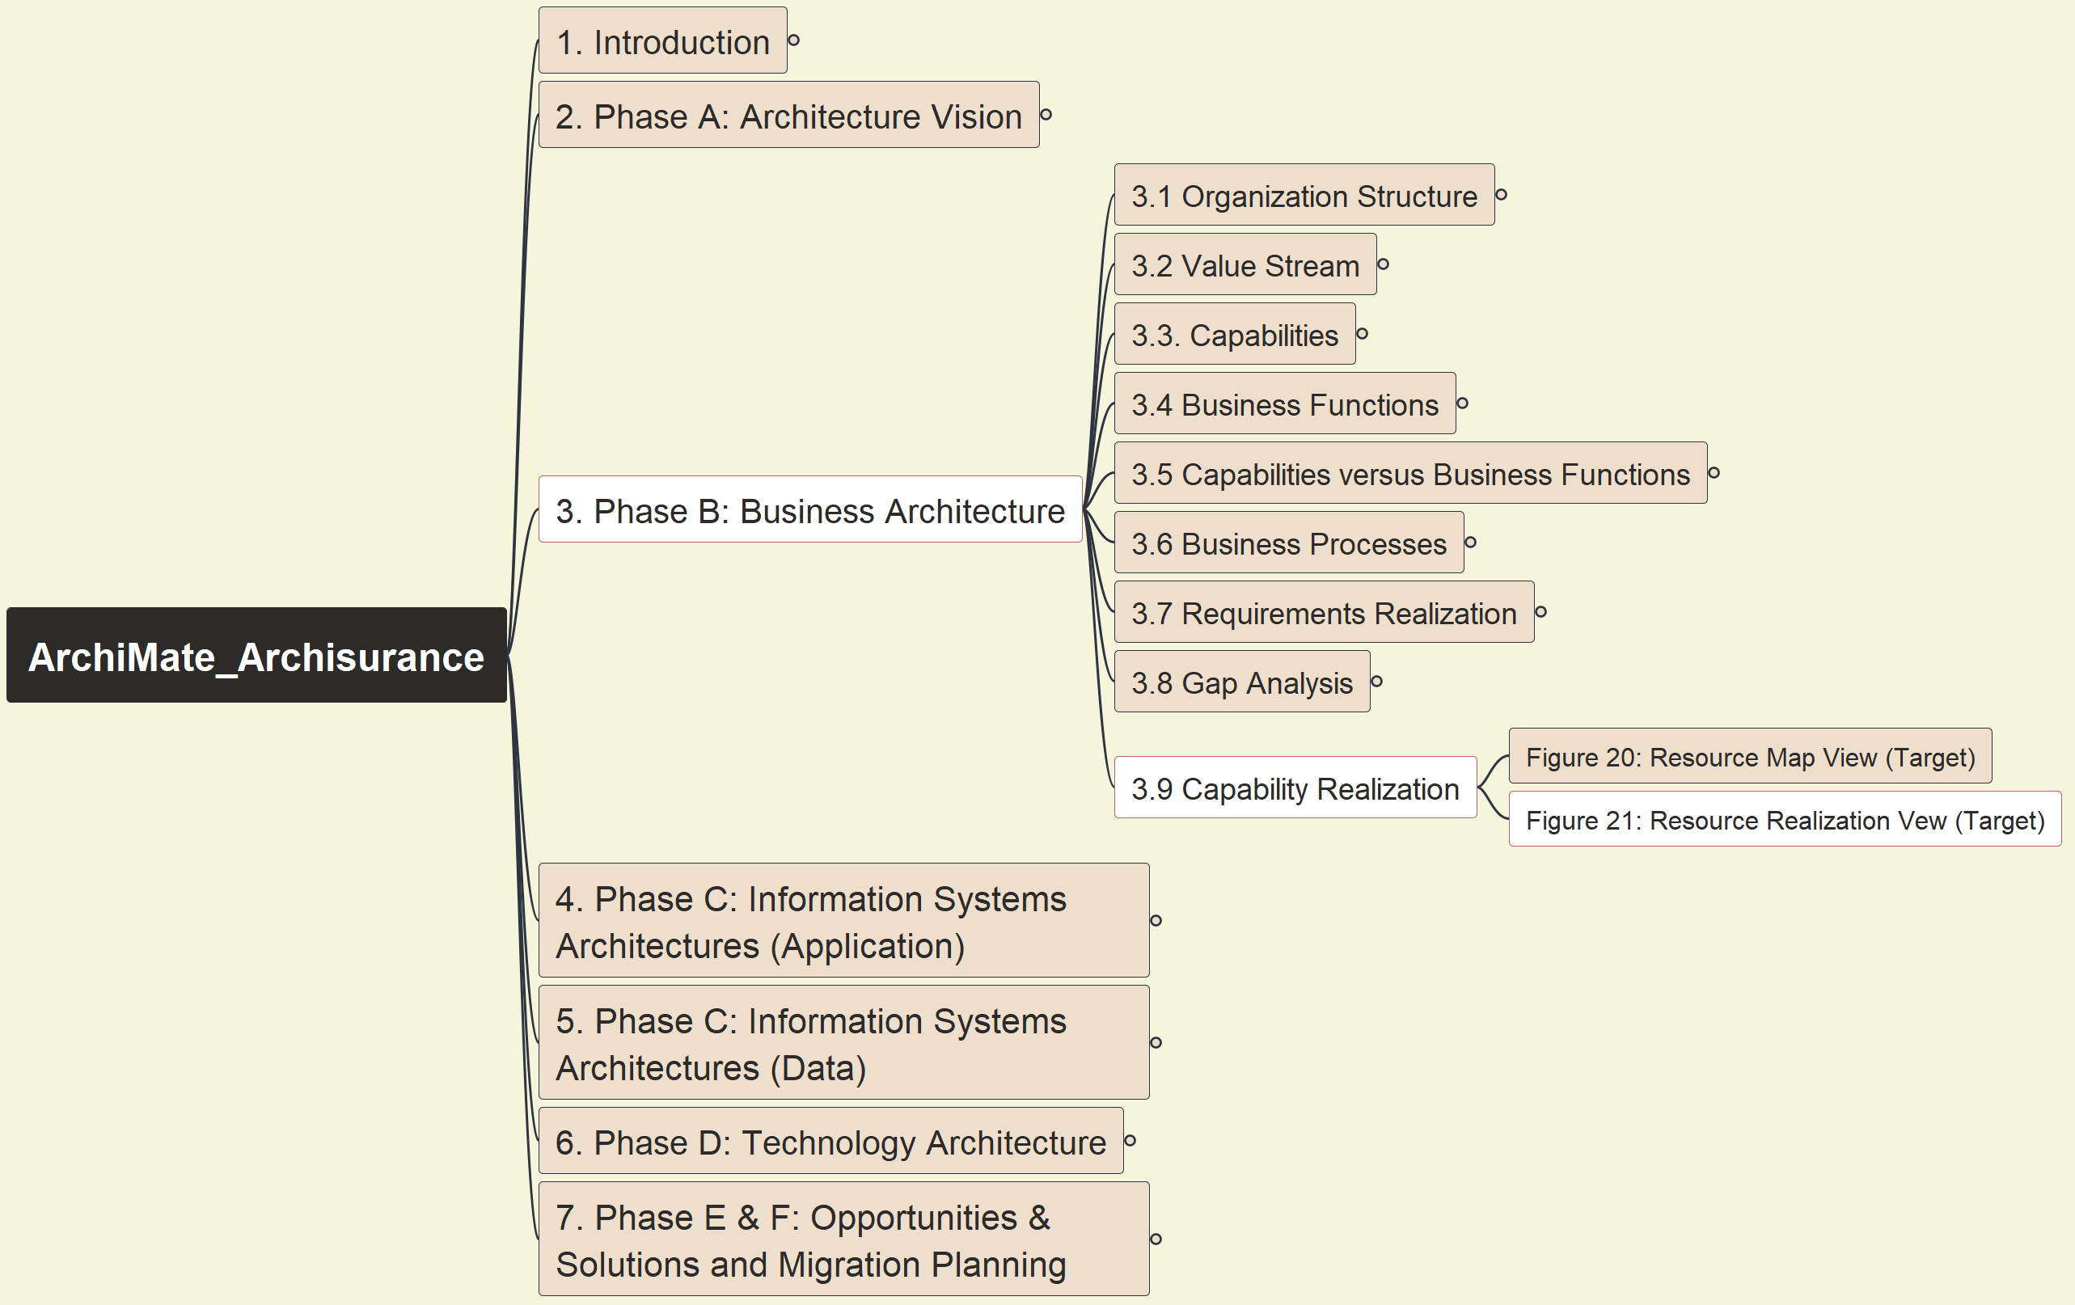
Phase B: Business Architecture - Figure 21: Resource Realization View (Target)
ArchiSurance 2025
023

Slide 29
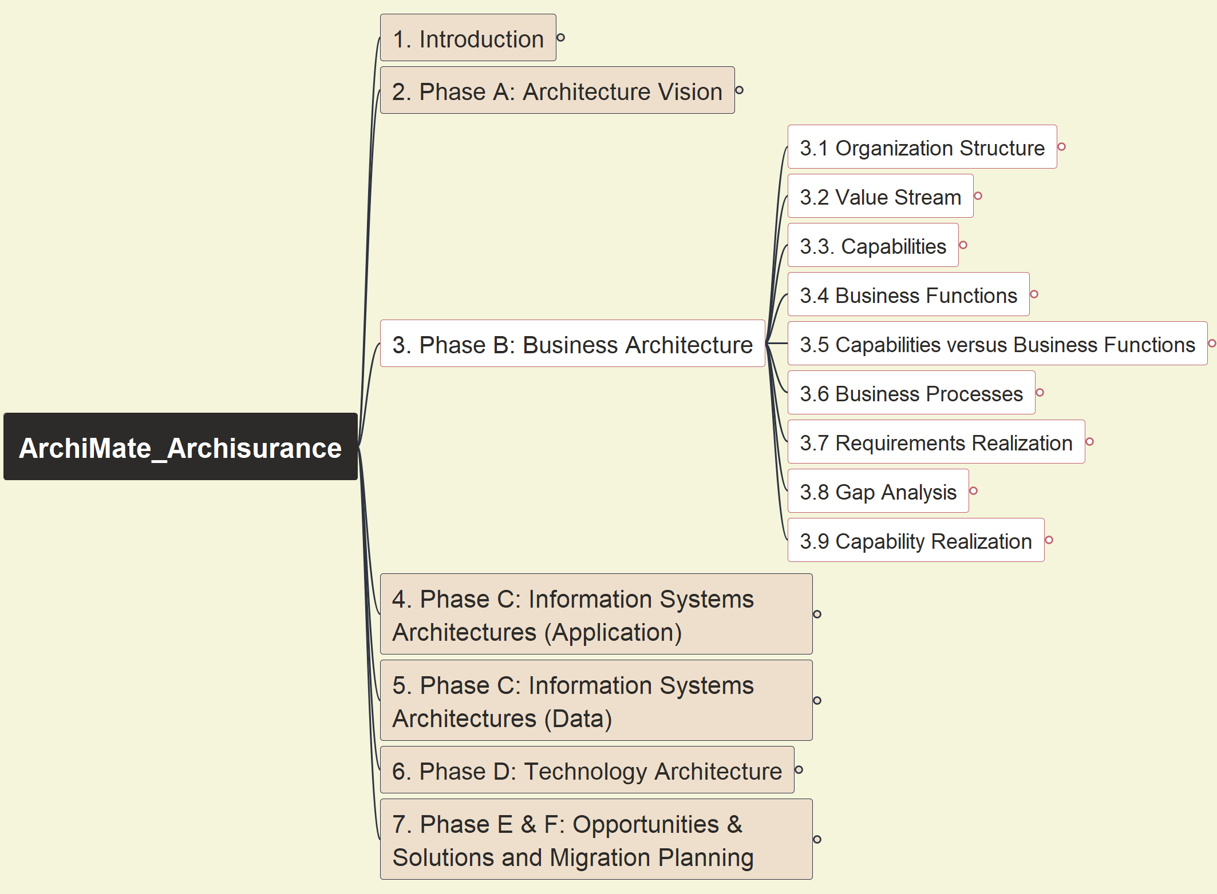

Phase B: Business Architecture - Ontology View on Strategy & Business Layer
ArchiSurance 2025
024

Slide 30


Phase C: Information System Architecture - App - Figure 22: Application Cooperation View (Baseline)
ArchiSurance 2025
025

Slide 31


Phase C: Information System Architecture - App - Figure 23: Application Cooperation View (Target)
ArchiSurance 2025
026

Slide 32


Phase C: Information System Architecture - App - Figure 24: Application Usage View (Baseline)
ArchiSurance 2025
027

Slide 33


Phase C: Information System Architecture - App - Figure 25: Application Behavior View (Target)
ArchiSurance 2025
028

Slide 34


Phase C: Information System Architecture - App - Figure 26: Application Arch. Gap Analysis
ArchiSurance 2025
029

Slide 35


Phase C: Information System Architecture - Data - Figure 27: Info Structure View – Business Objects
ArchiSurance 2025
030

Slide 36


Phase C: Information System Architecture - Data - Figure 28: Data Dissemination Diagram
ArchiSurance 2025
031

Slide 37


Phase D: Technology Architecture - Figure 29: Technology View (Baseline)
ArchiSurance 2025
032

Slide 38


Phase D: Technology Architecture - Figure 30: Technology View (Target)
ArchiSurance 2025
033

Slide 39


Phase D: Technology Architecture - Figure 31: Data Acquisition from IoT Services (Target)
ArchiSurance 2025
034

Slide 40


Phase D: Technology Architecture - Figure 32: IoT Services (Target)
ArchiSurance 2025
035

Slide 41


Phase D: Technology Architecture - Figure 33: Technology Gap Analysis
ArchiSurance 2025
036

Slide 42


Phase E&F: Opportunities & Solutions and Migration Planning - Figure 34: Migration View
ArchiSurance 2025
037

Slide 43


Phase E&F: Opportunities & Solutions and Migration Planning - Figure 35: TOGAF Project Context Diagram
ArchiSurance 2025
038

Slide 44

Summary: Archi Model with Ontology View
ArchiSurance 2025
039

Slide 45






My Courses About ArchiMate®

Slide 46



